Slide 1

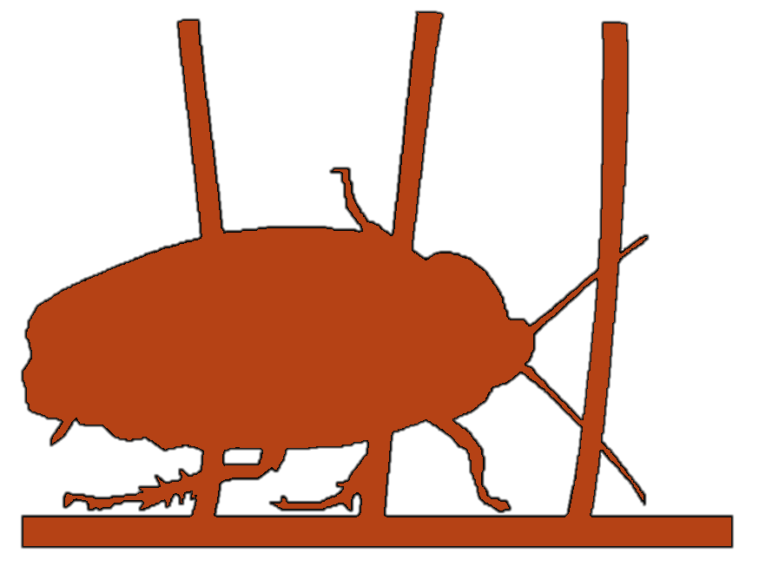
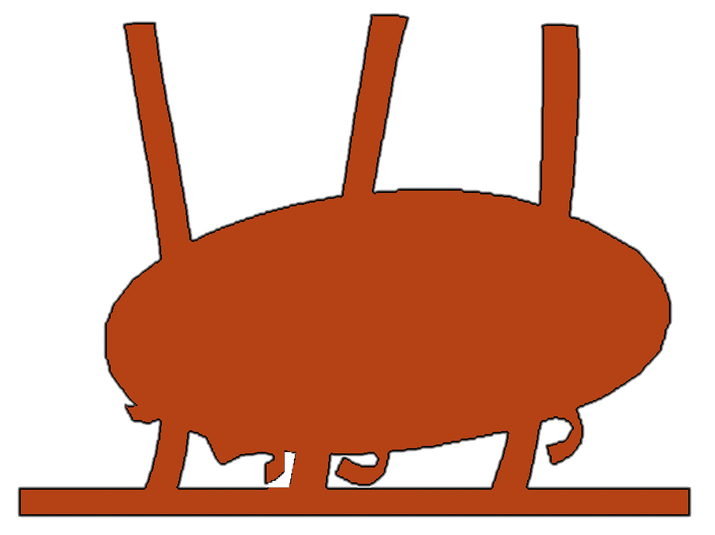



Terradynamics Lab
Movement Science at the Interface of Biology, Robotics, & Physics
Cockroach Robot Locomotion Over Complex Obstacles
Yuxiao Li
yuxiaoli@uchicago.edu
Laboratory for Computational Sensing & Robotics
Johns Hopkins University

Slide 2
MuJoCo
Basic Model
Model Construction: video is shown
Data Analysis: Refine the contact model (including friction) by evaluating parameters, including force (xyz) and torque (roll, pitch, and yaw)
Extended Model
Model Construction: videos are shown
Data Analysis: 1. Evaluate the probability of transitions from pitch to roll
2. Examine transition time and traversal time

Slide 3
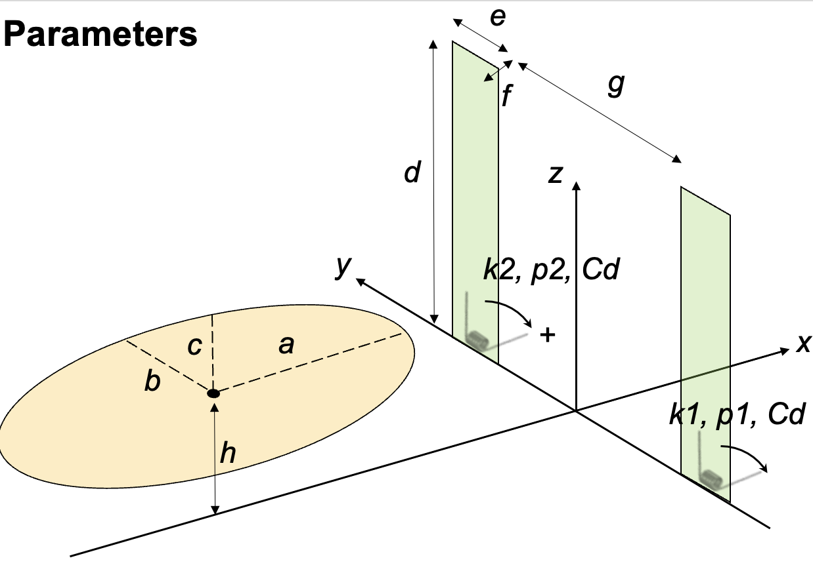
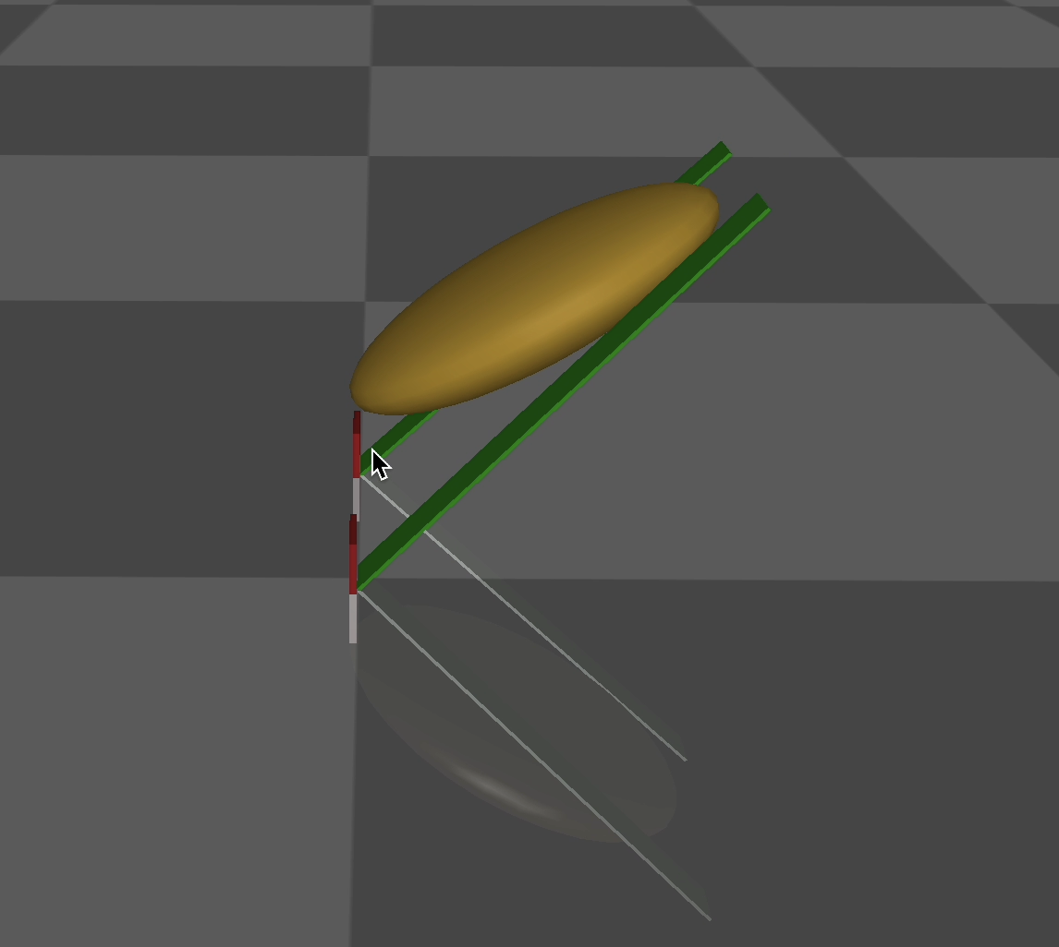
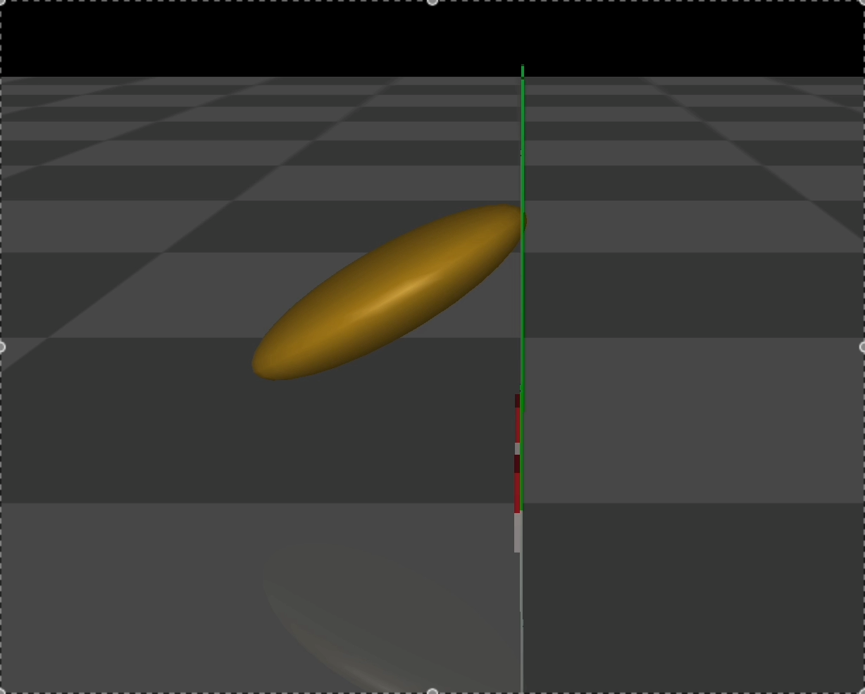
Basic Model: Model Construction
-30
Moving in x direction: 16mm/s
Movement from -100 mm to 100 mm in the x-axis
Two conditions:
When roll = -5, pitch = -30 (example shown above)
(2) When roll = -5, pitch = -40

Slide 4
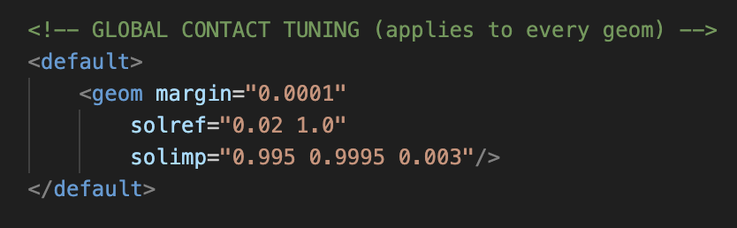
Basic Model: Data Analysis – Contact Model
Contact Model
solref = “timeconst dampratio”
time constant (s): larger -> softer contact (slower correction)
damping ratio (unitless): 1.0 ≈ critically damped, <1 under-damped, and >1 over-damped
solimp = “d0 dwidth width”
d0 (unitless, 0 - 1): impedance at contact
dwidth (unitless, 0 - 1): impedance at r = width
width (m): exponent/nonlinearity of the stiffness curve -> controls how quickly stiffness ramps up between the two thresholds
Specific values are shown on the right
(their testing is demonstrated in the next slides)

Slide 5
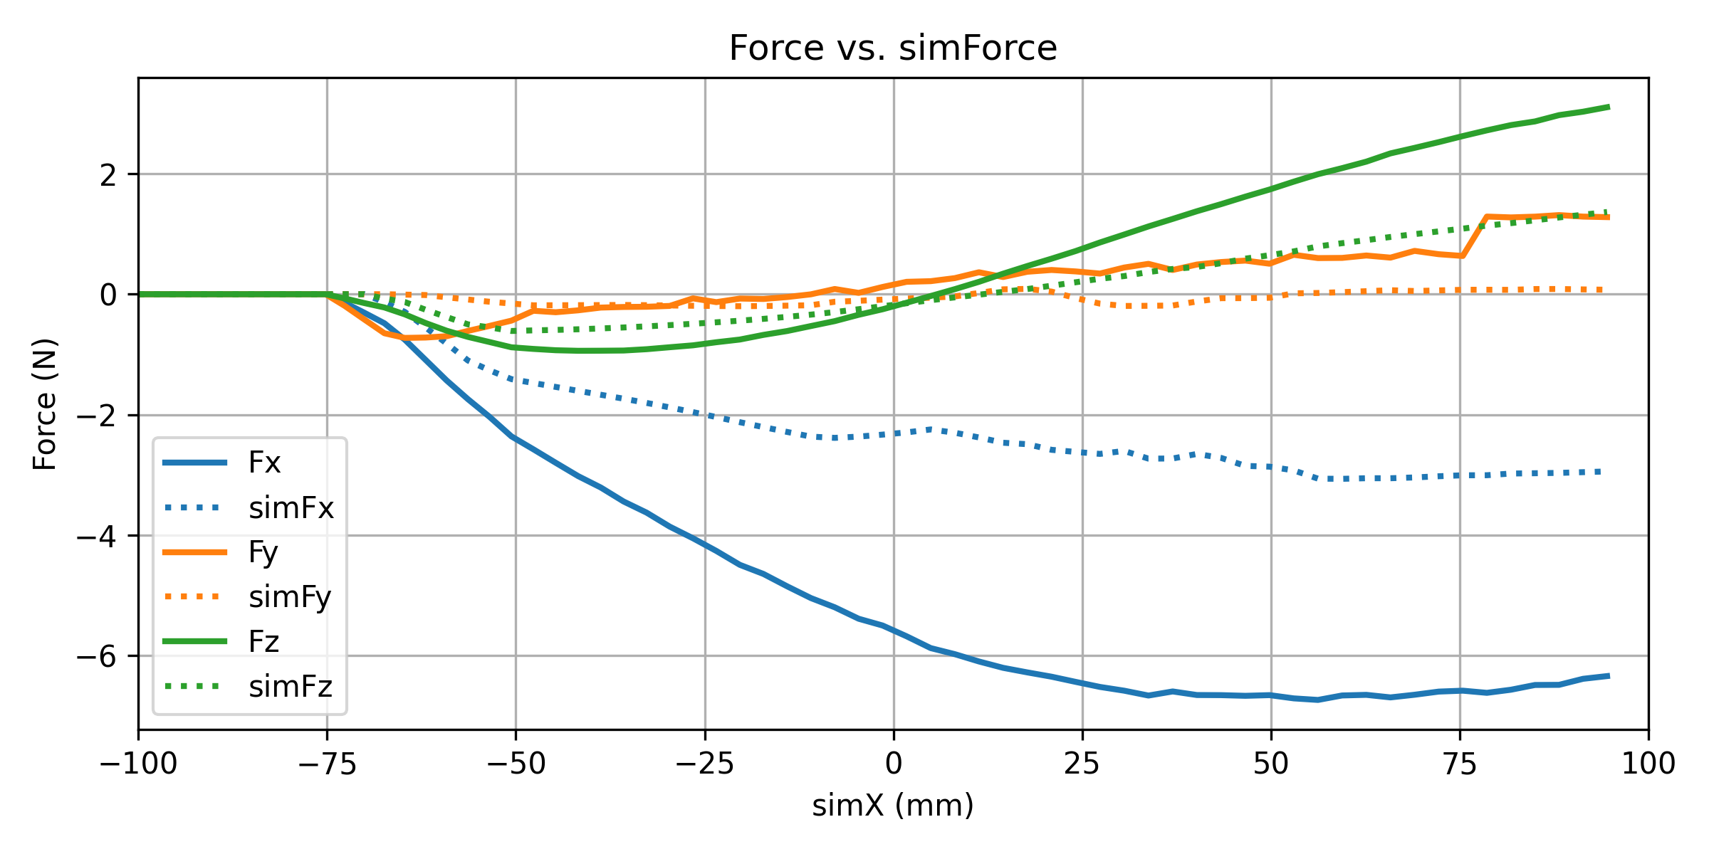
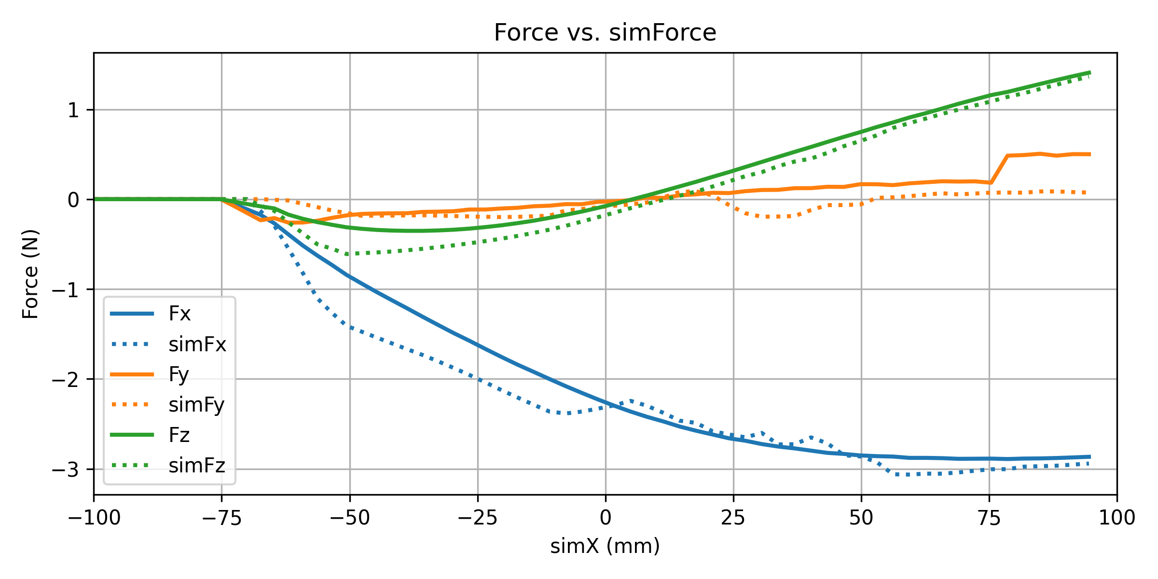
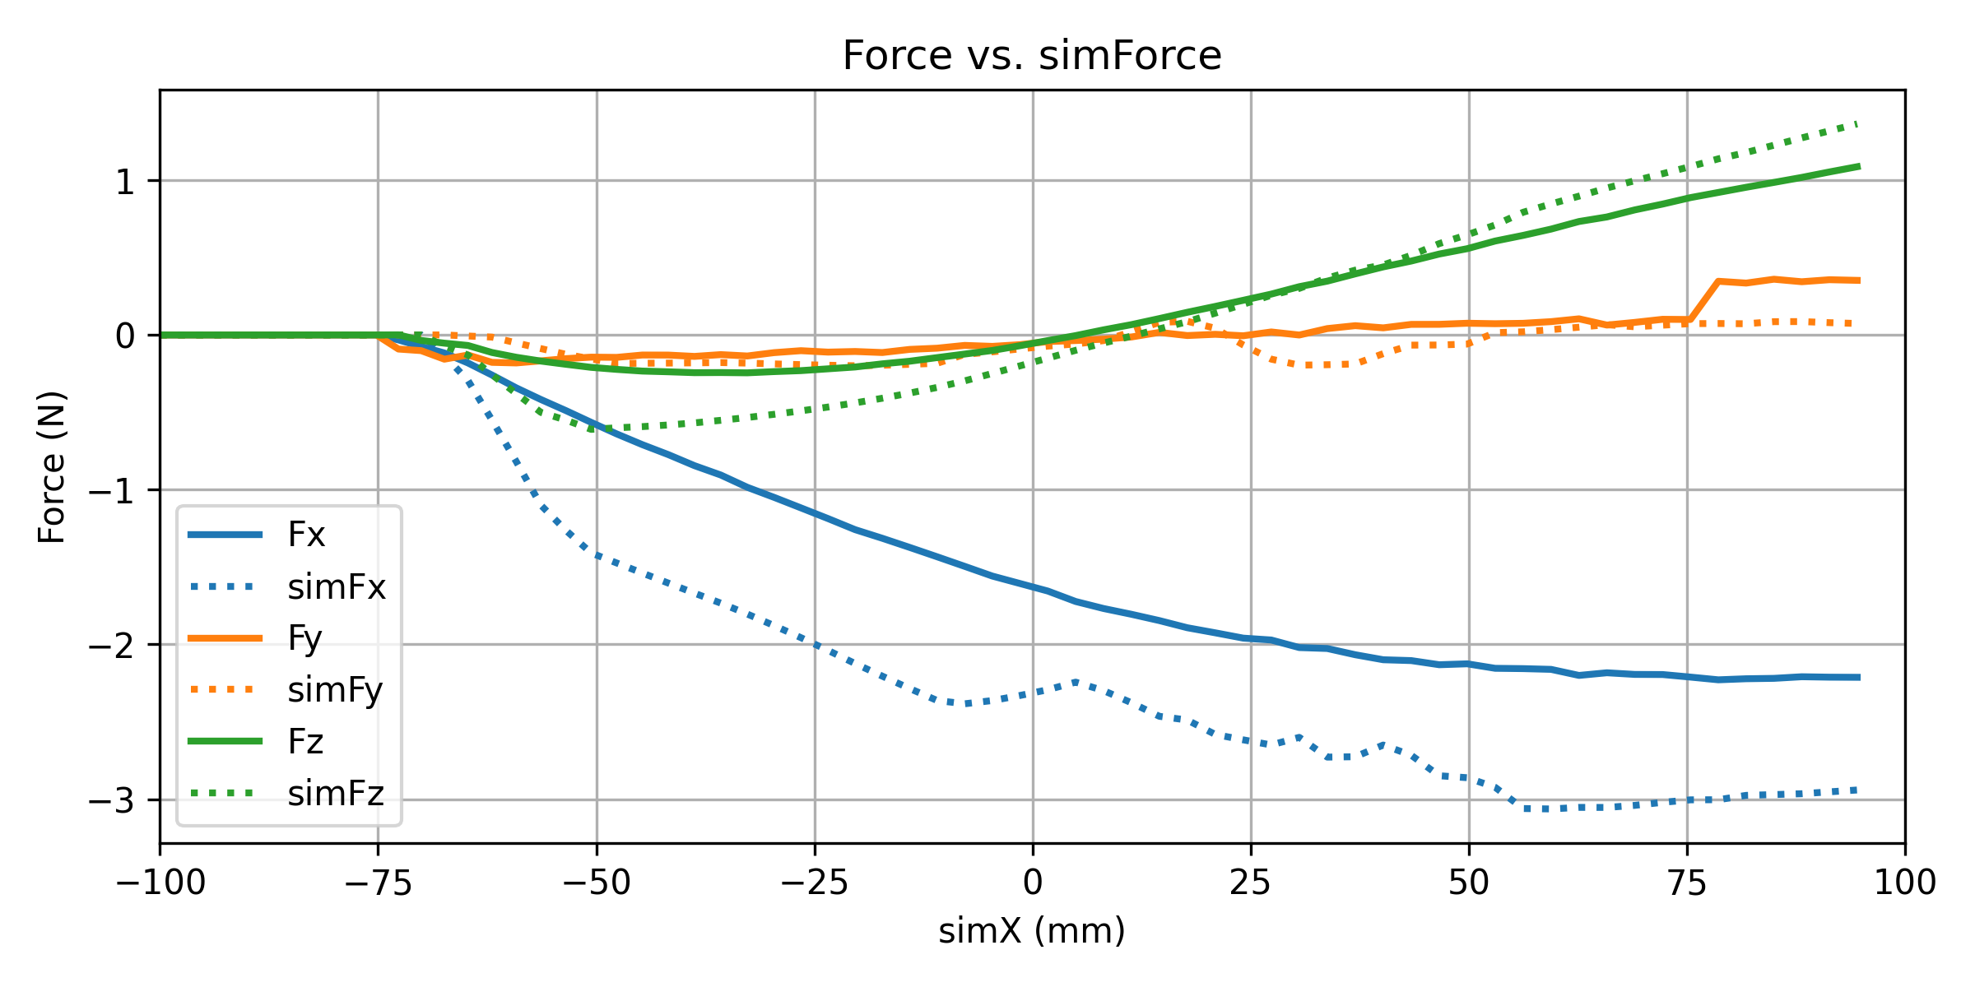
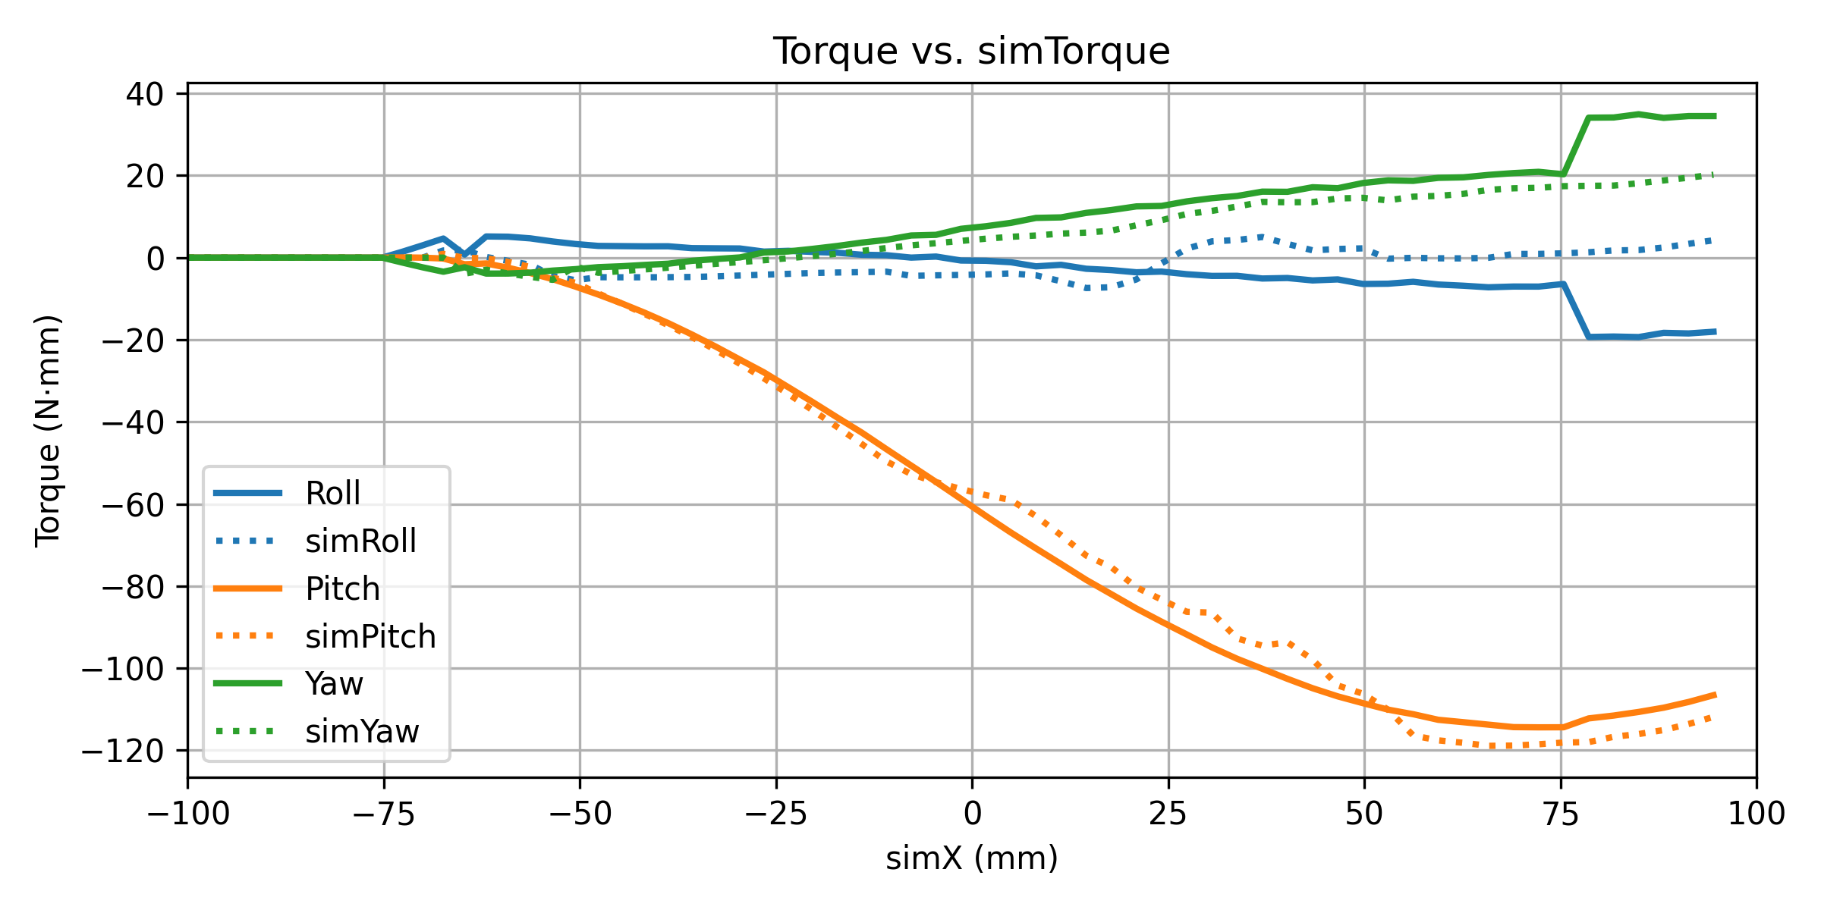
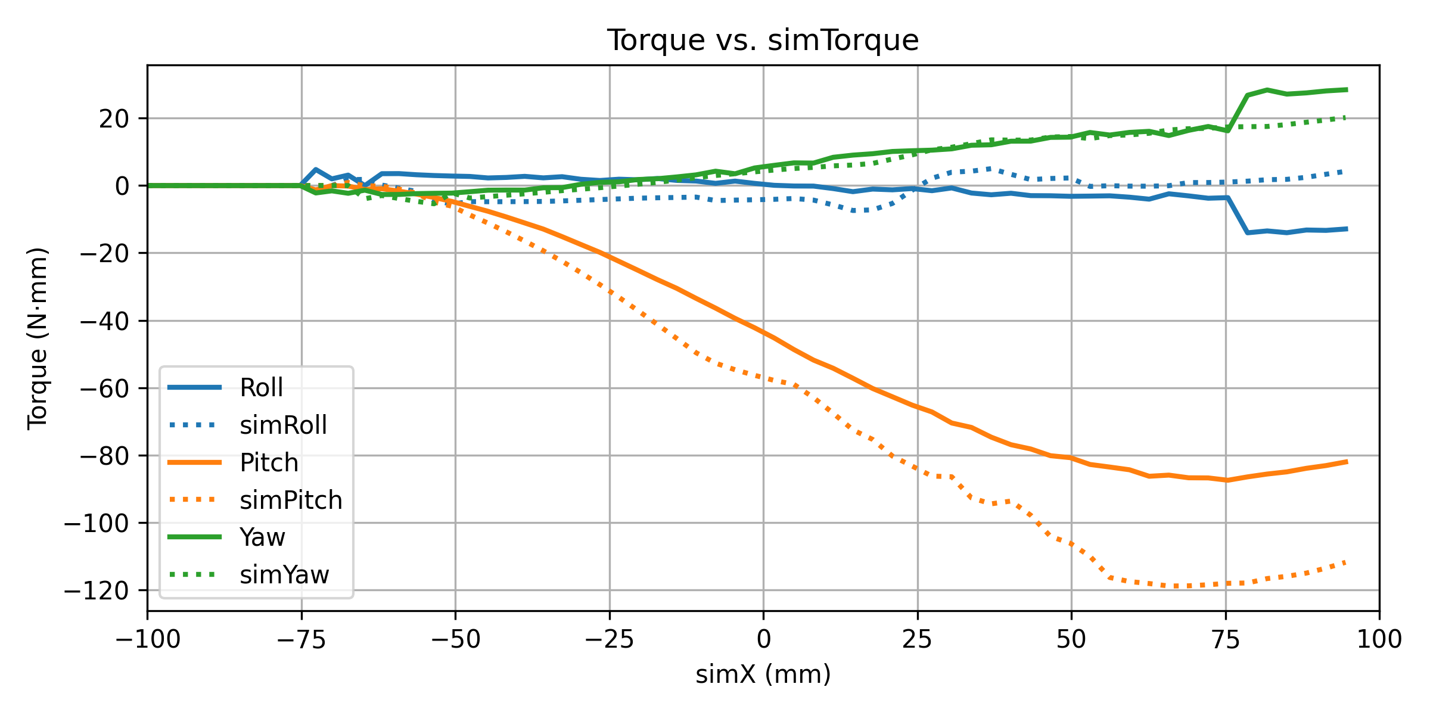
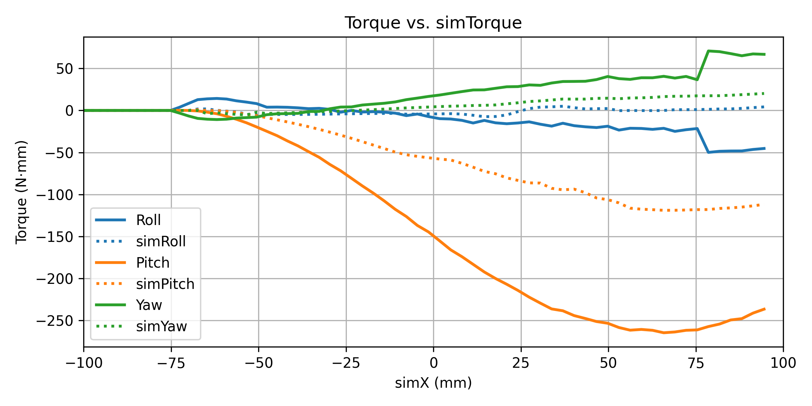
Data Analysis: Contact Model (Roll -5, Pitch -30)
Time constant = 0.01s
Time constant = 0.02s
Time constant = 0.03s
The solid line is my data and dotted line is the expected result

Slide 6
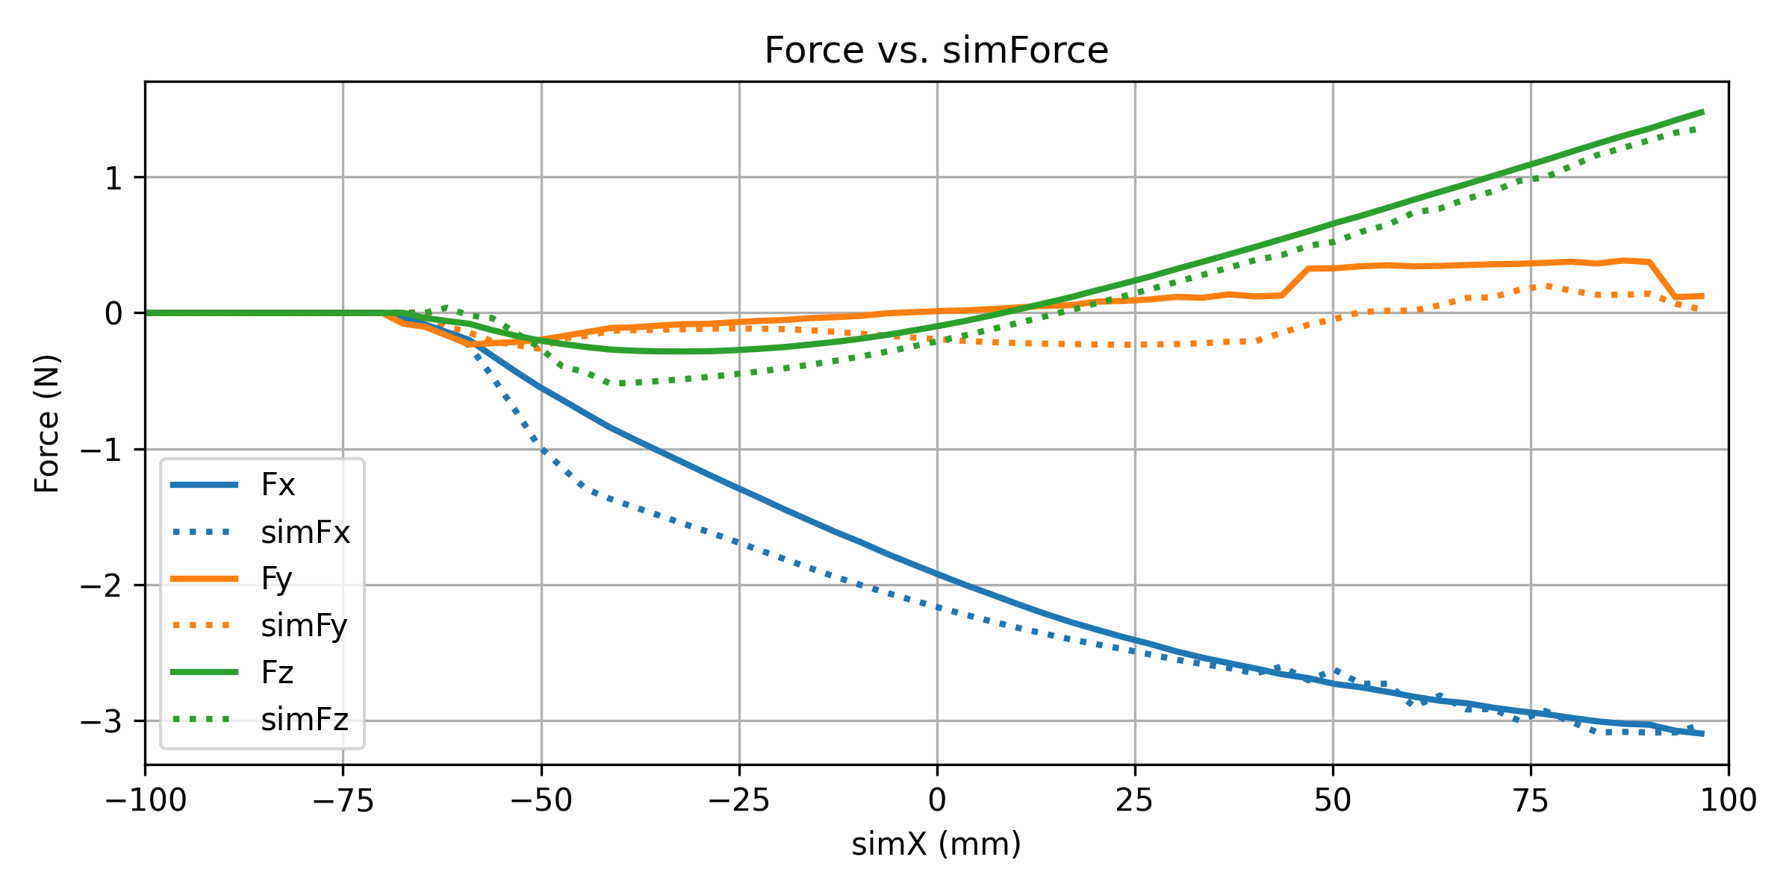
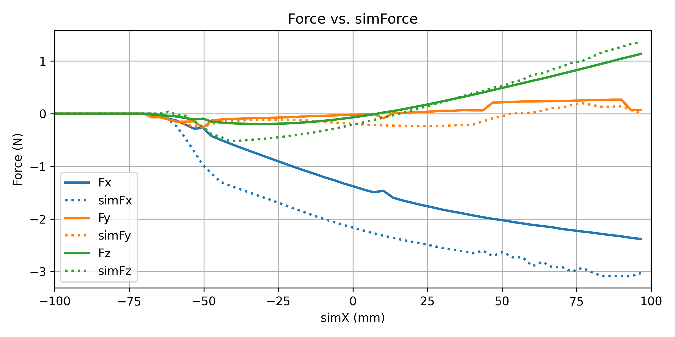
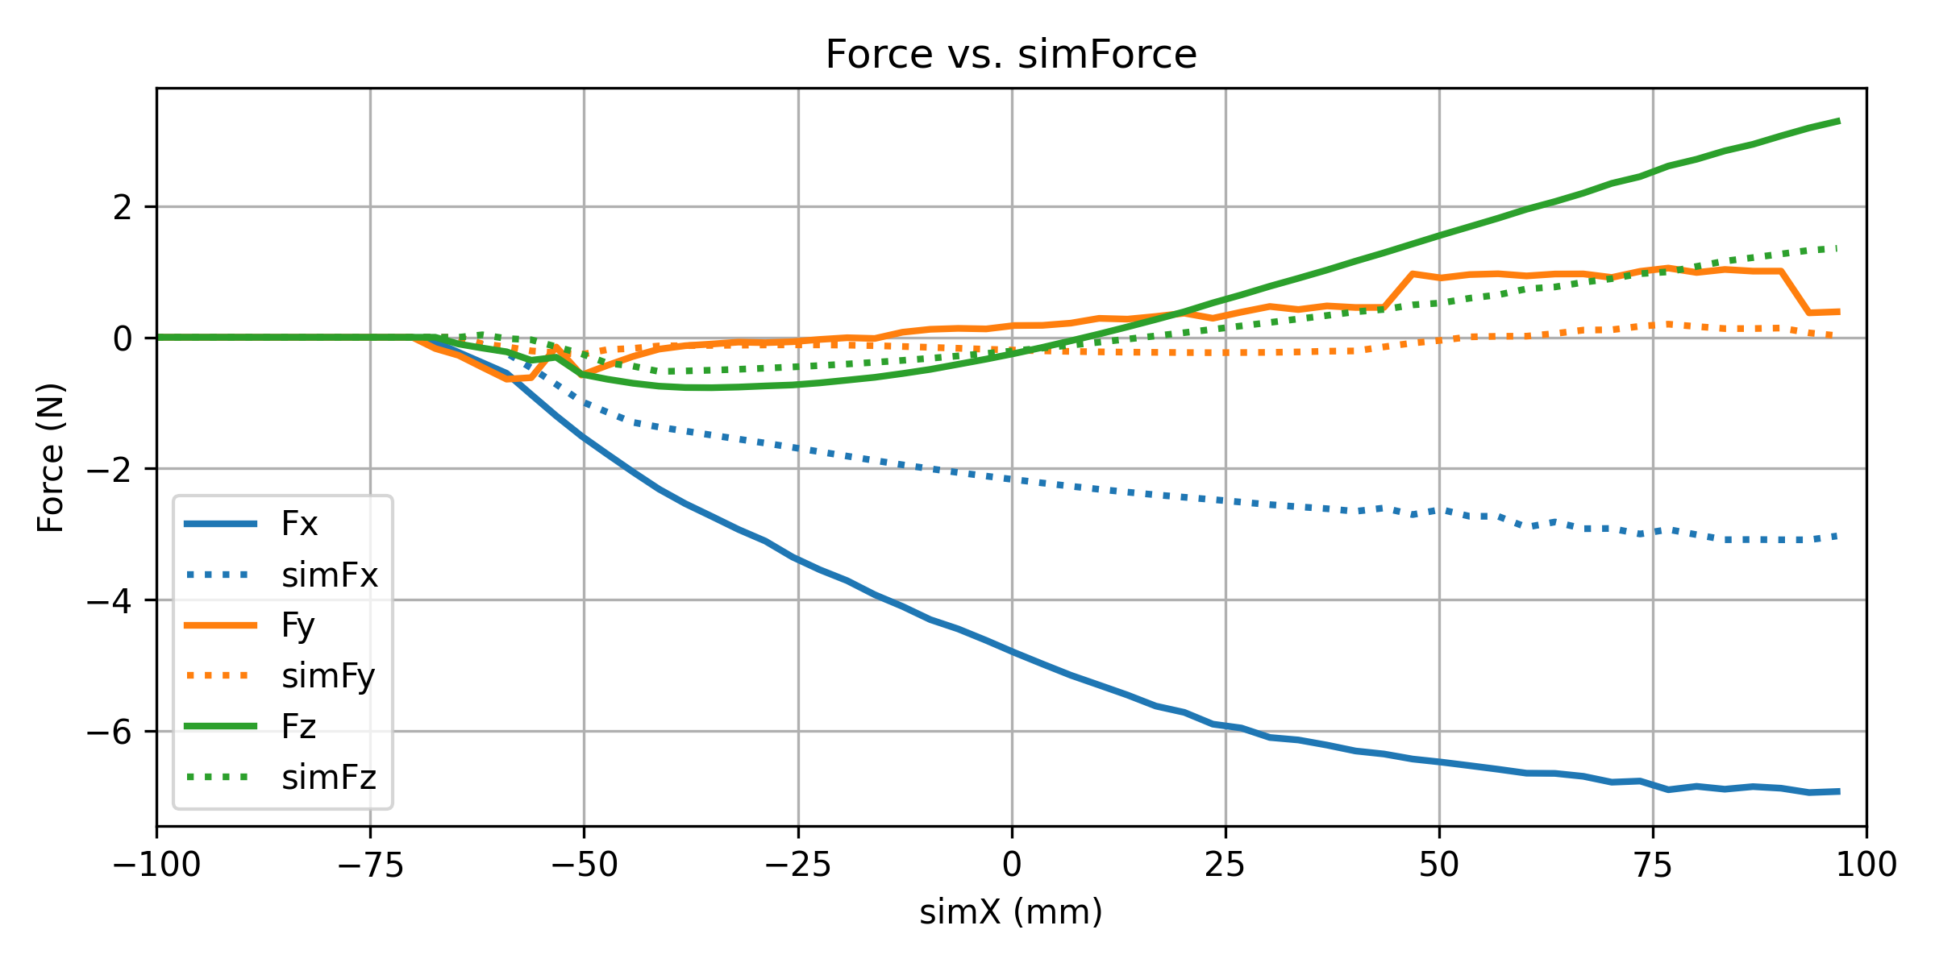
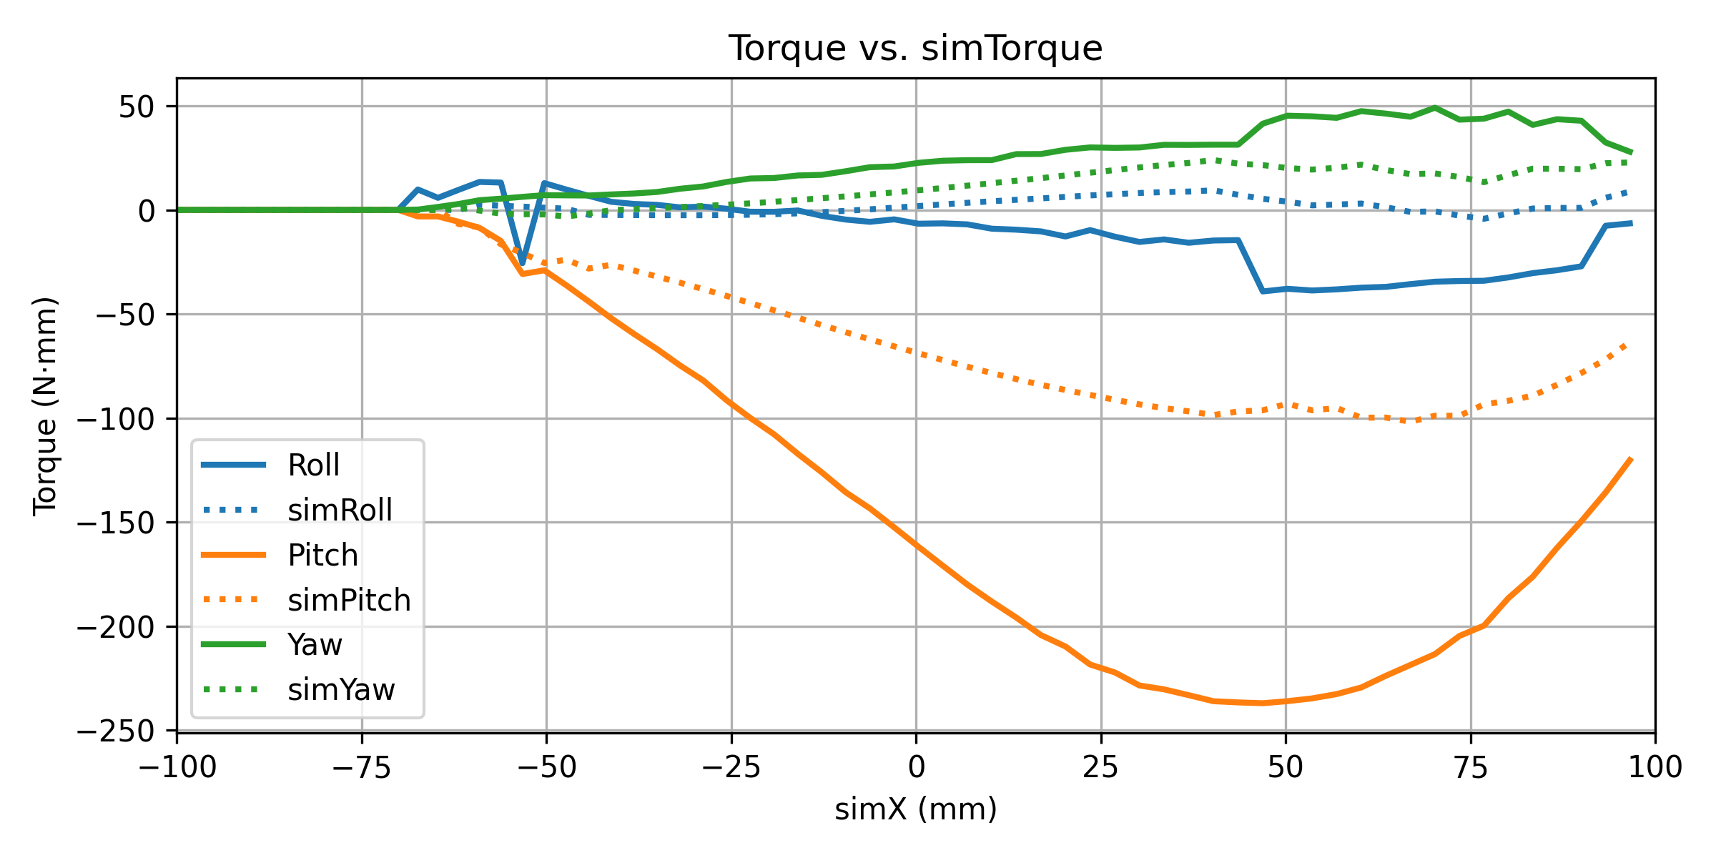
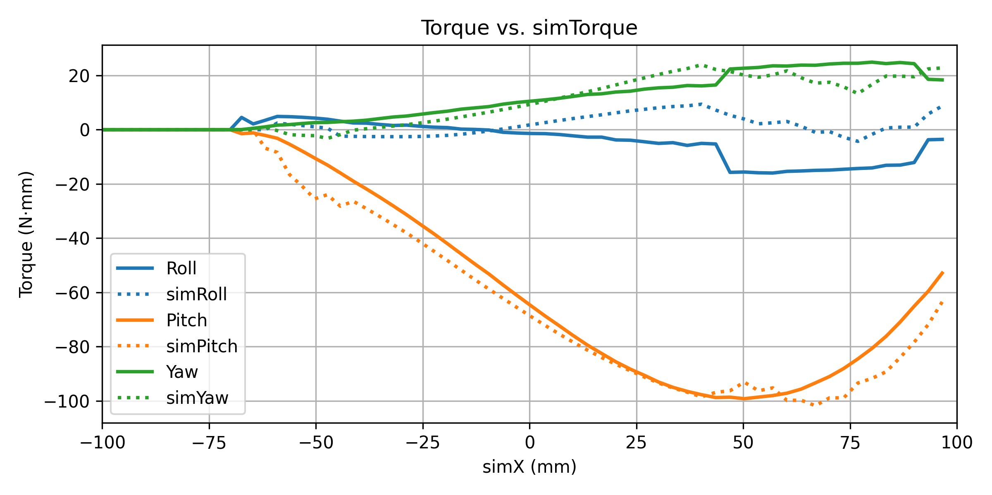
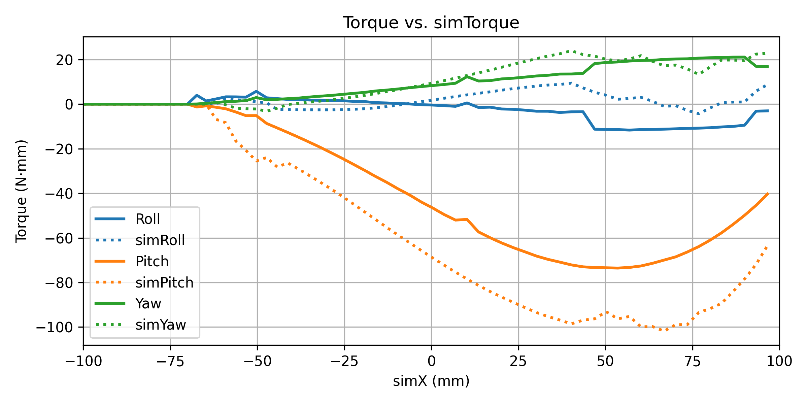
Data Analysis: Contact Model (Roll -5, Pitch -40)
Time constant = 0.01s
Time constant = 0.02s
Time constant = 0.03s
The solid line is my data and dotted line is the expected result

Slide 7
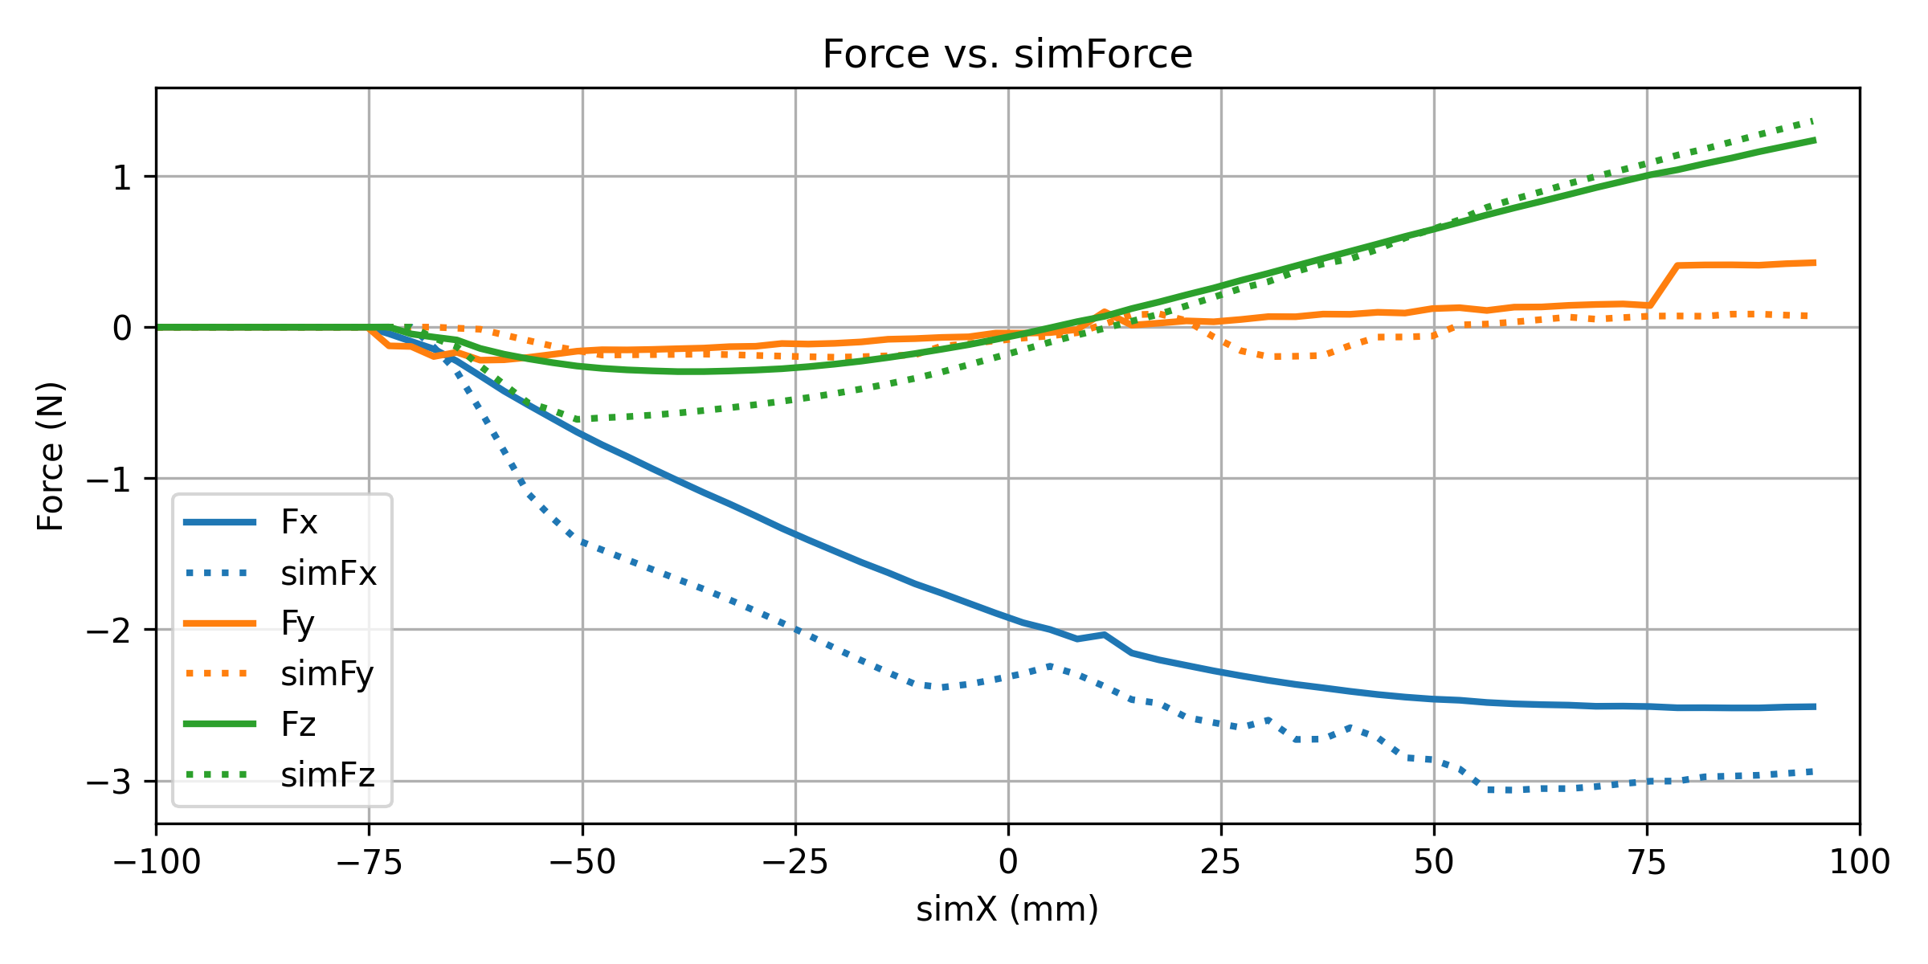
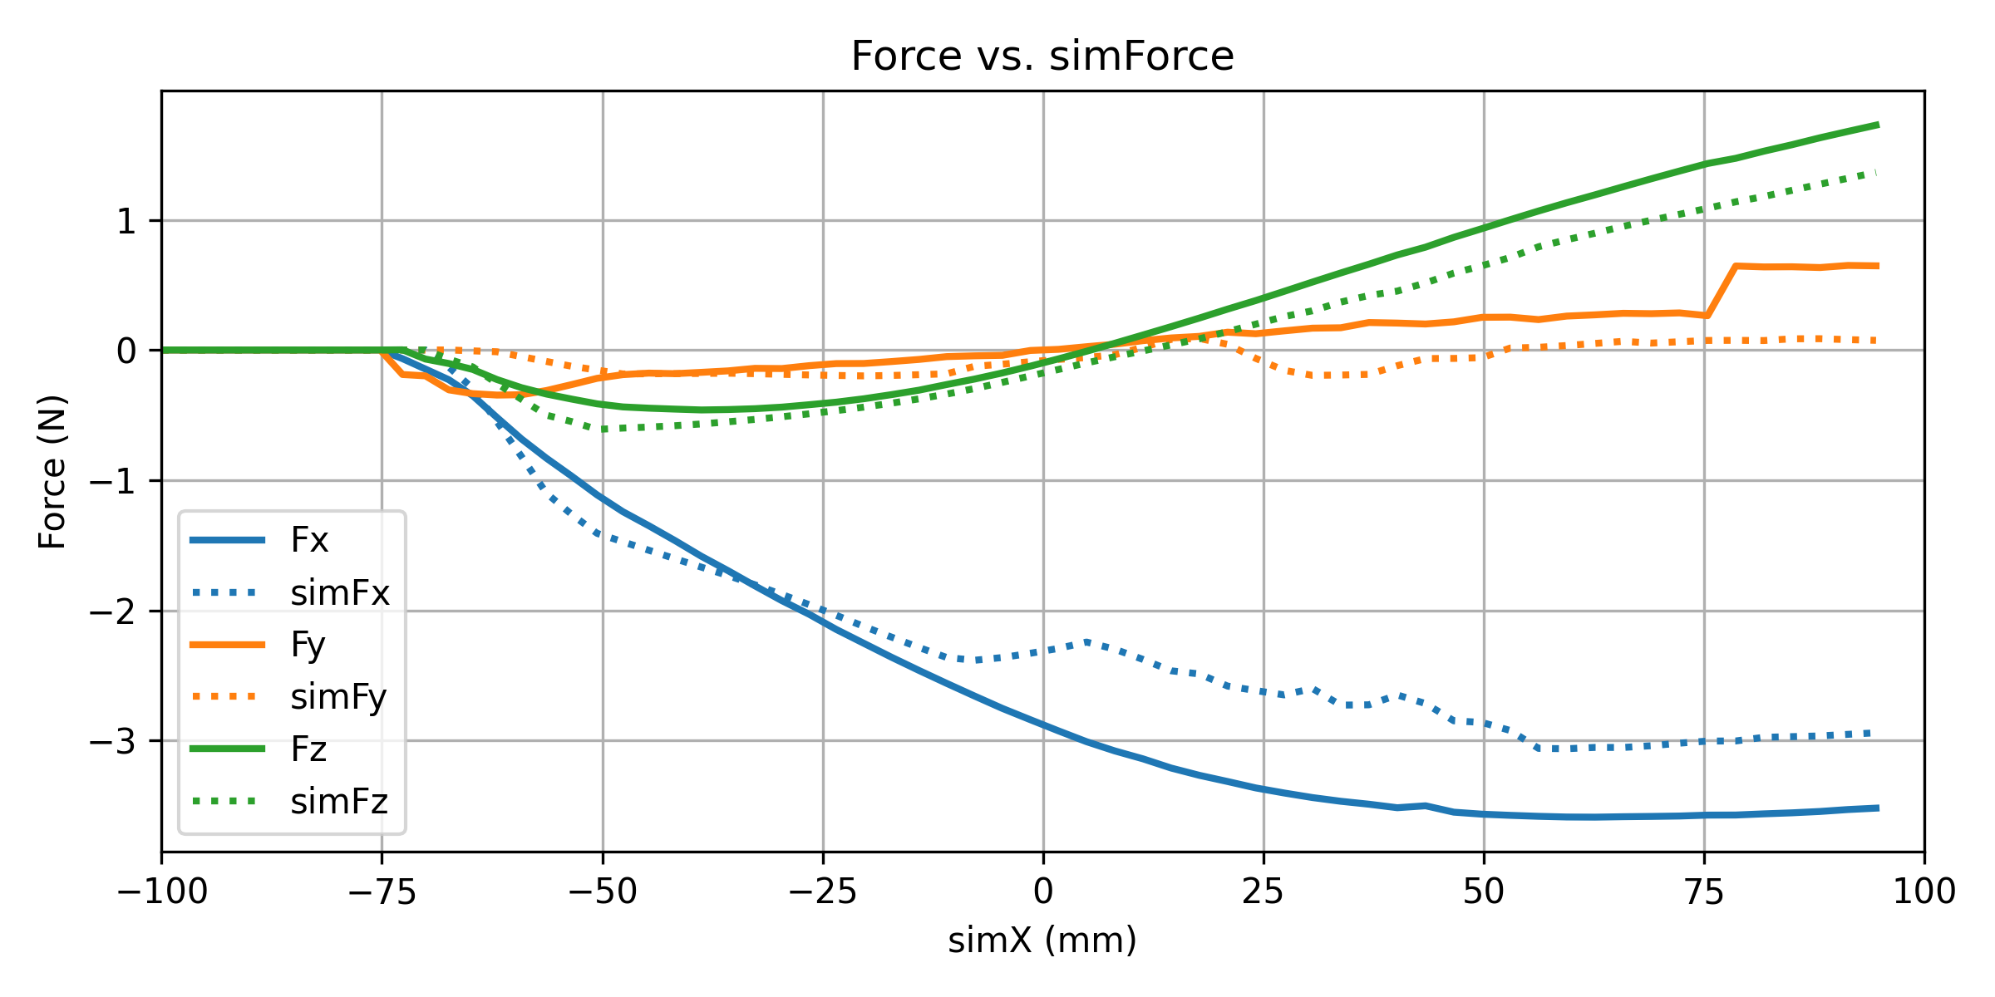
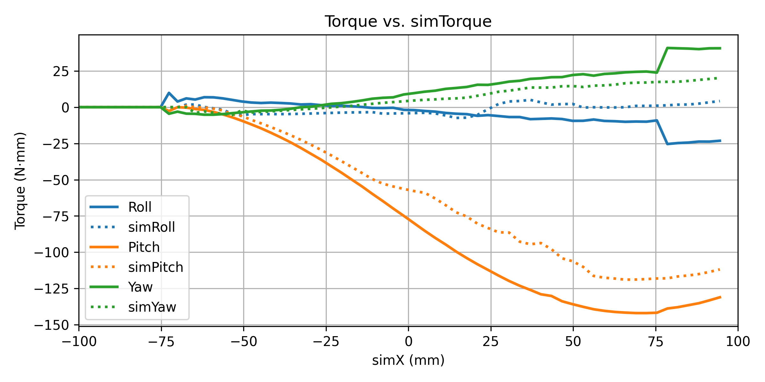
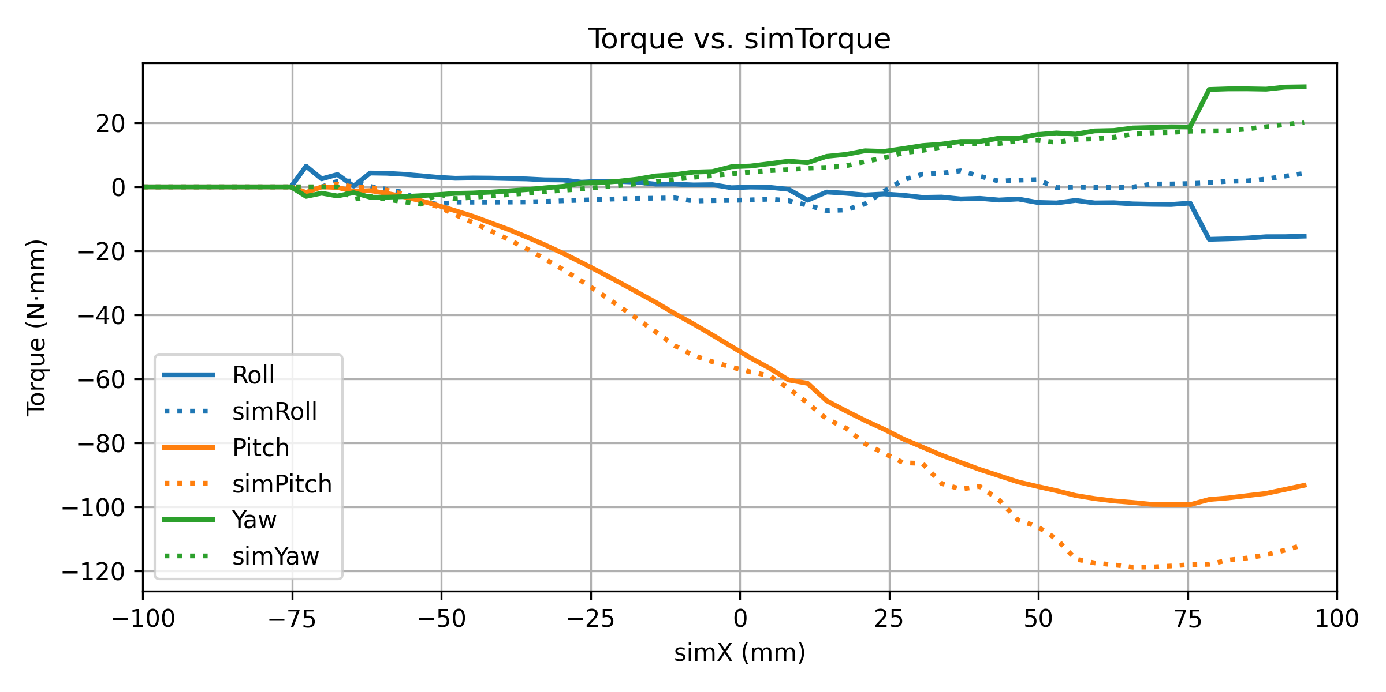
Data Analysis: Contact Model (Roll -5, Pitch -30)
Damp ratio = 0.8
Damp ratio = 1.0
Damp ratio = 1.2
The solid line is my data and dotted line is the expected result

Slide 8
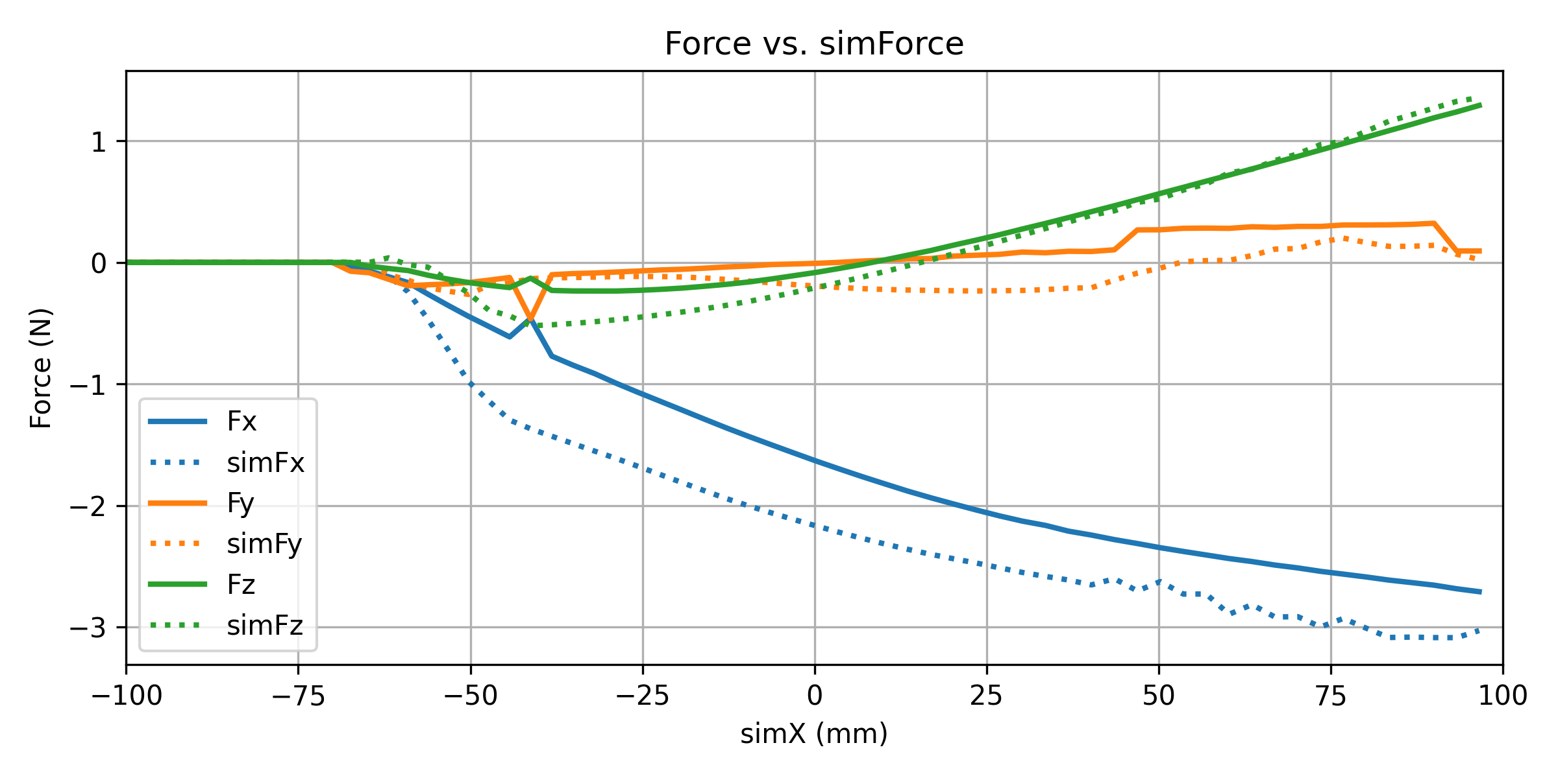

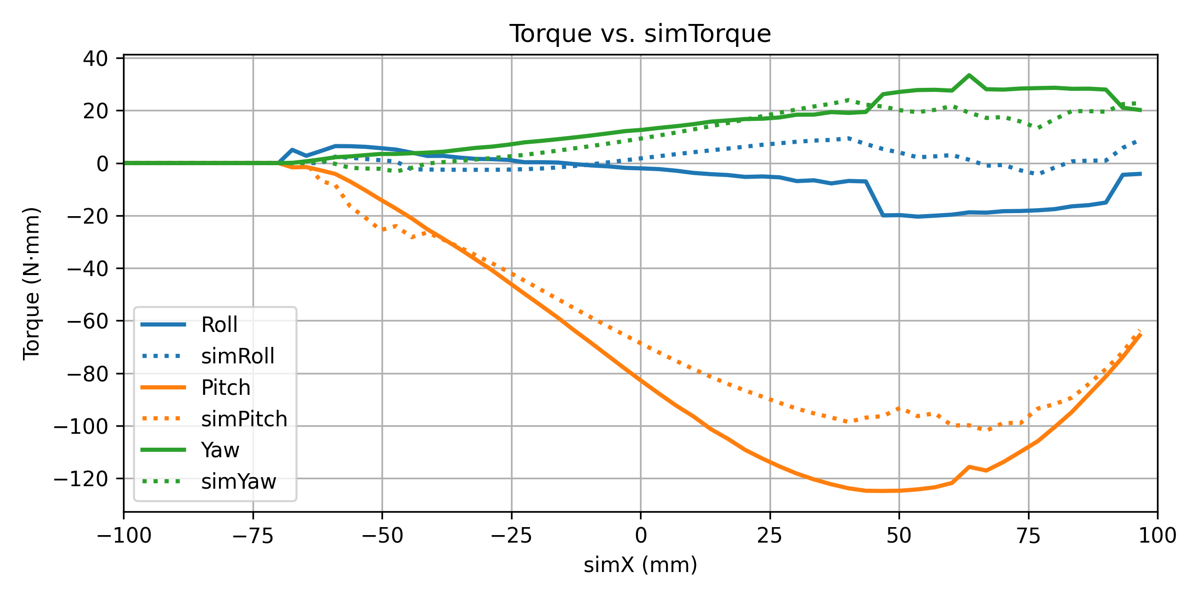
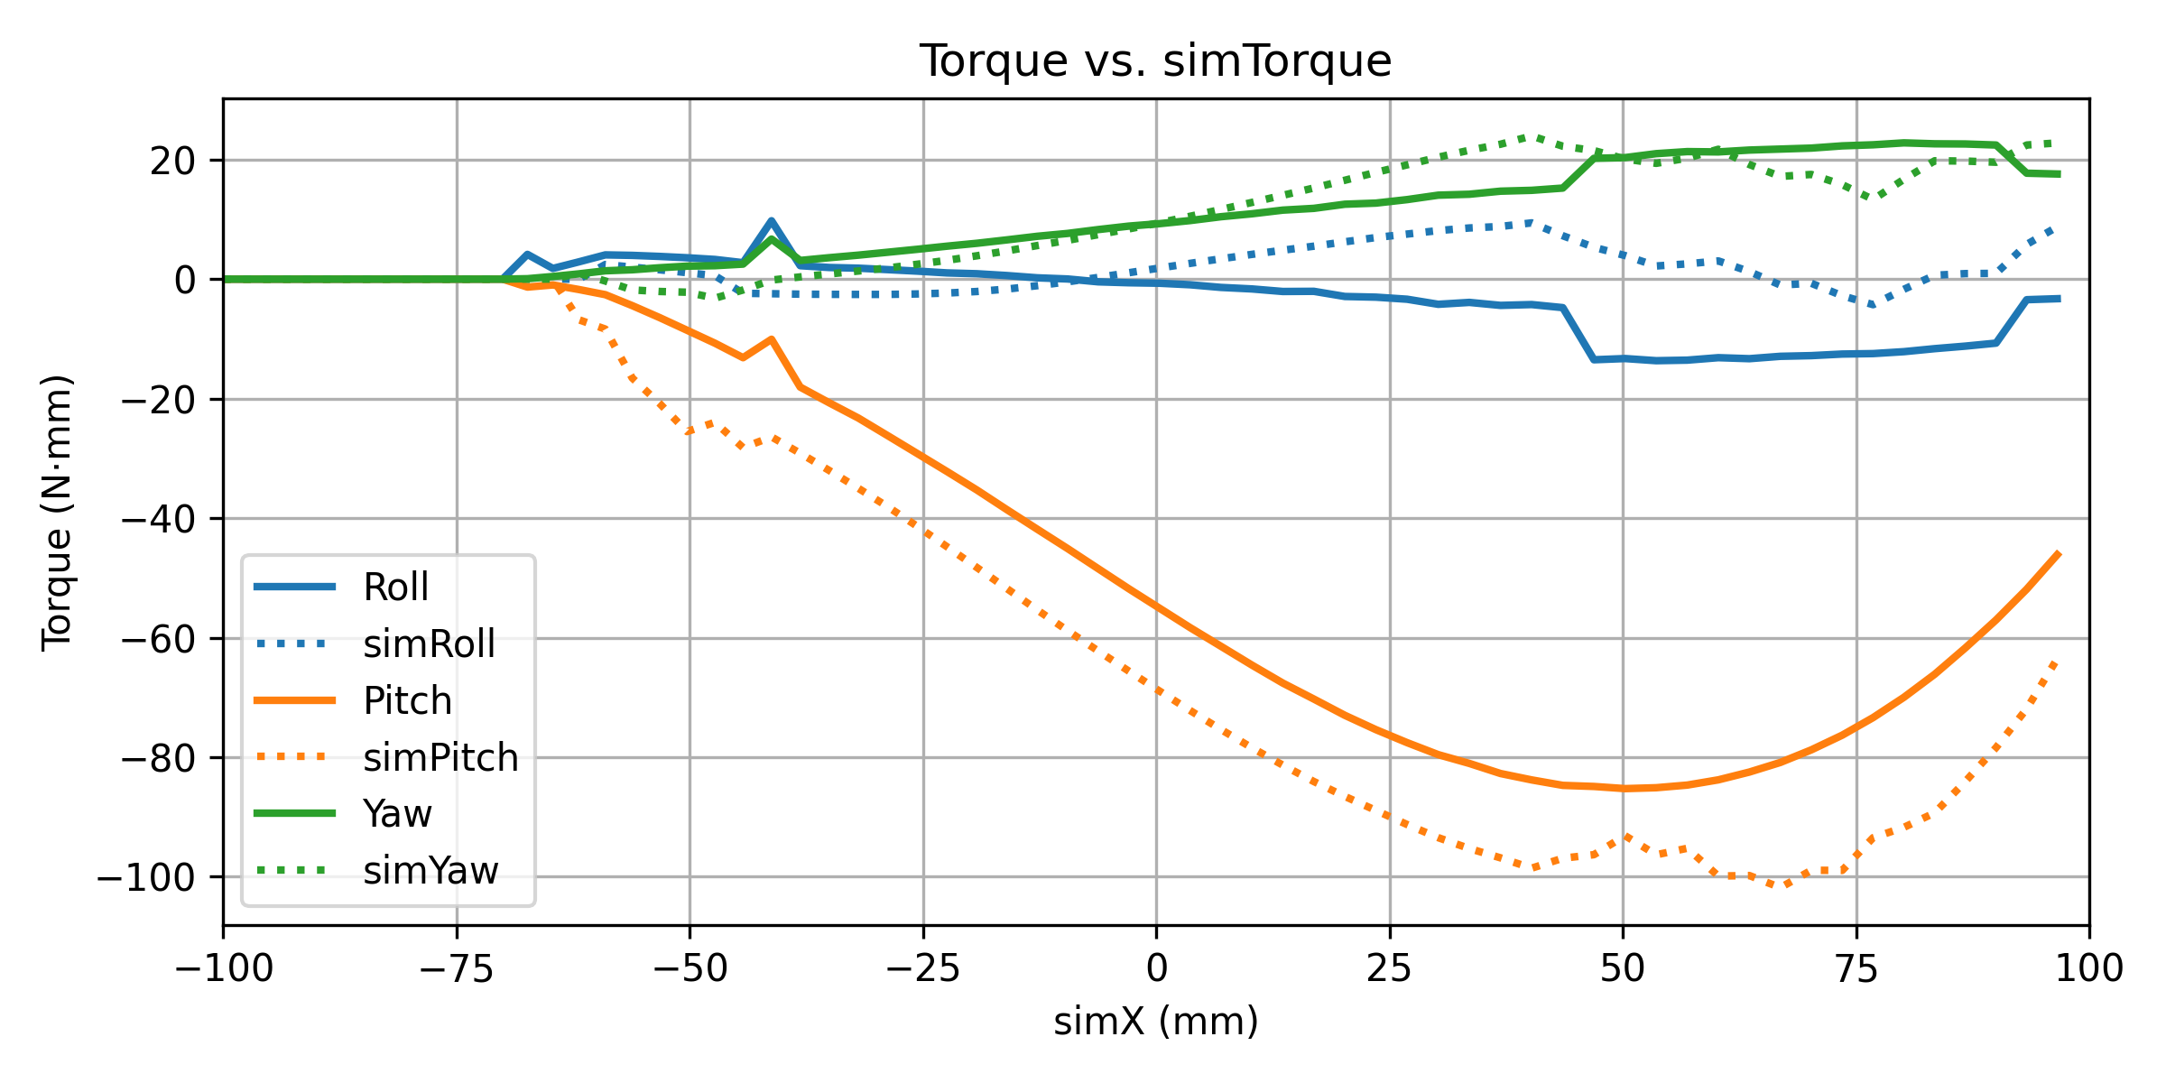
Data Analysis: Contact Model (Roll -5, Pitch -40)
Damp ratio = 0.8
Damp ratio = 1.0
Damp ratio = 1.2
The solid line is my data and dotted line is the expected result

Slide 9
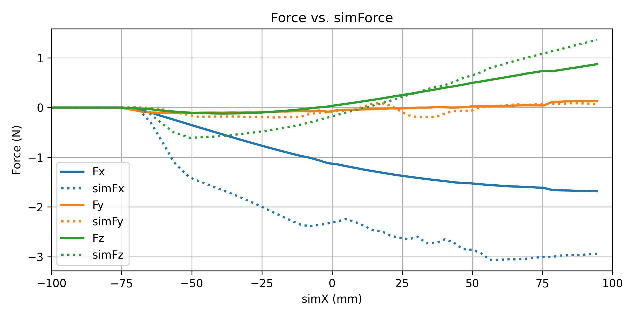
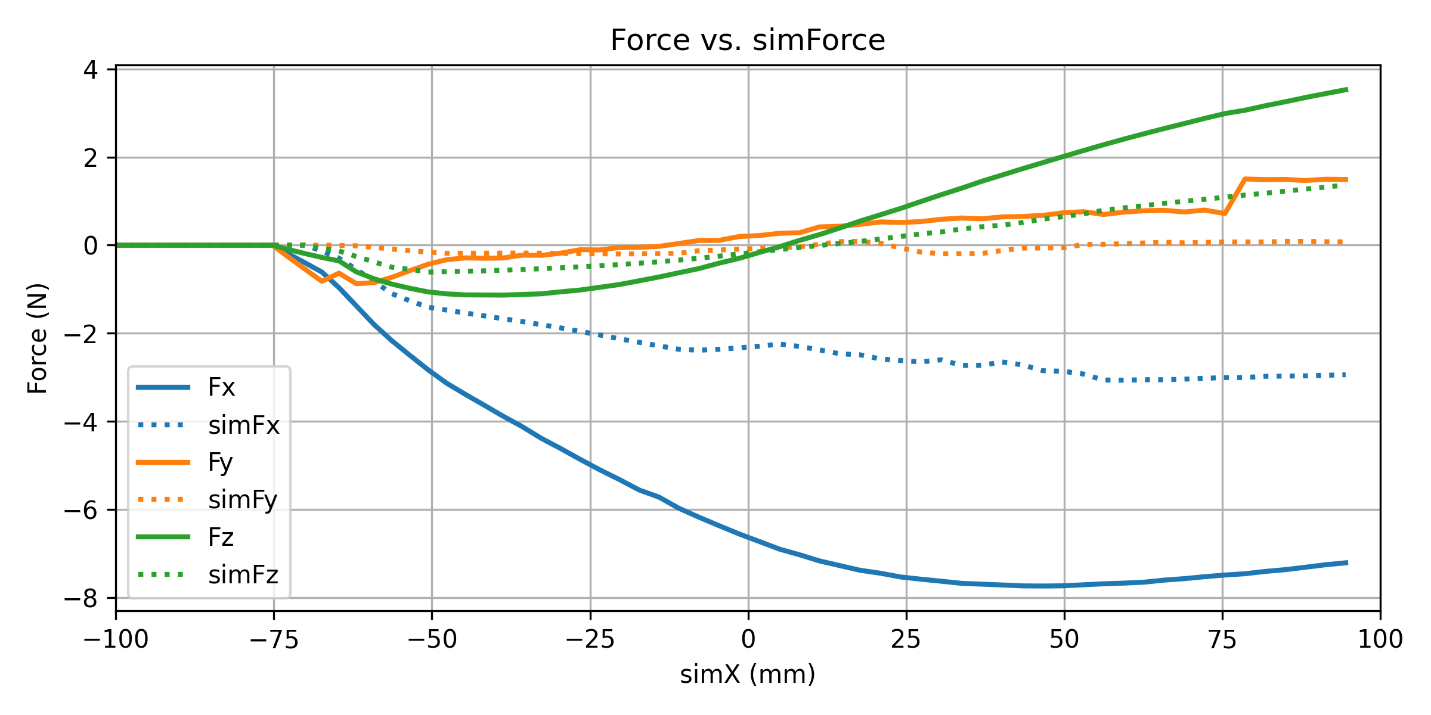
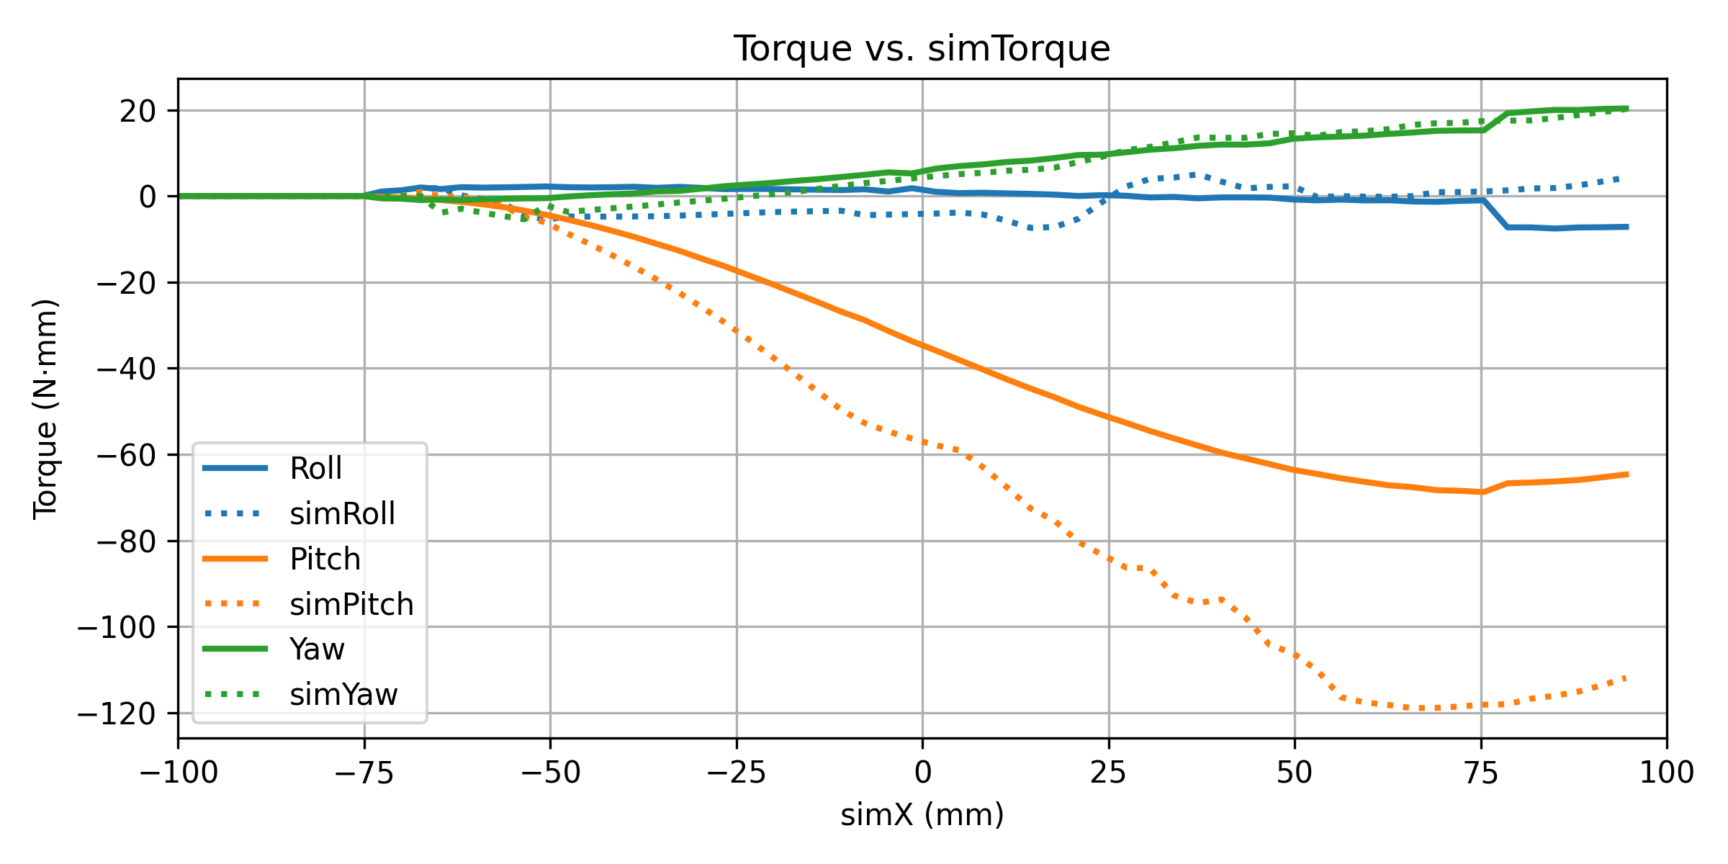
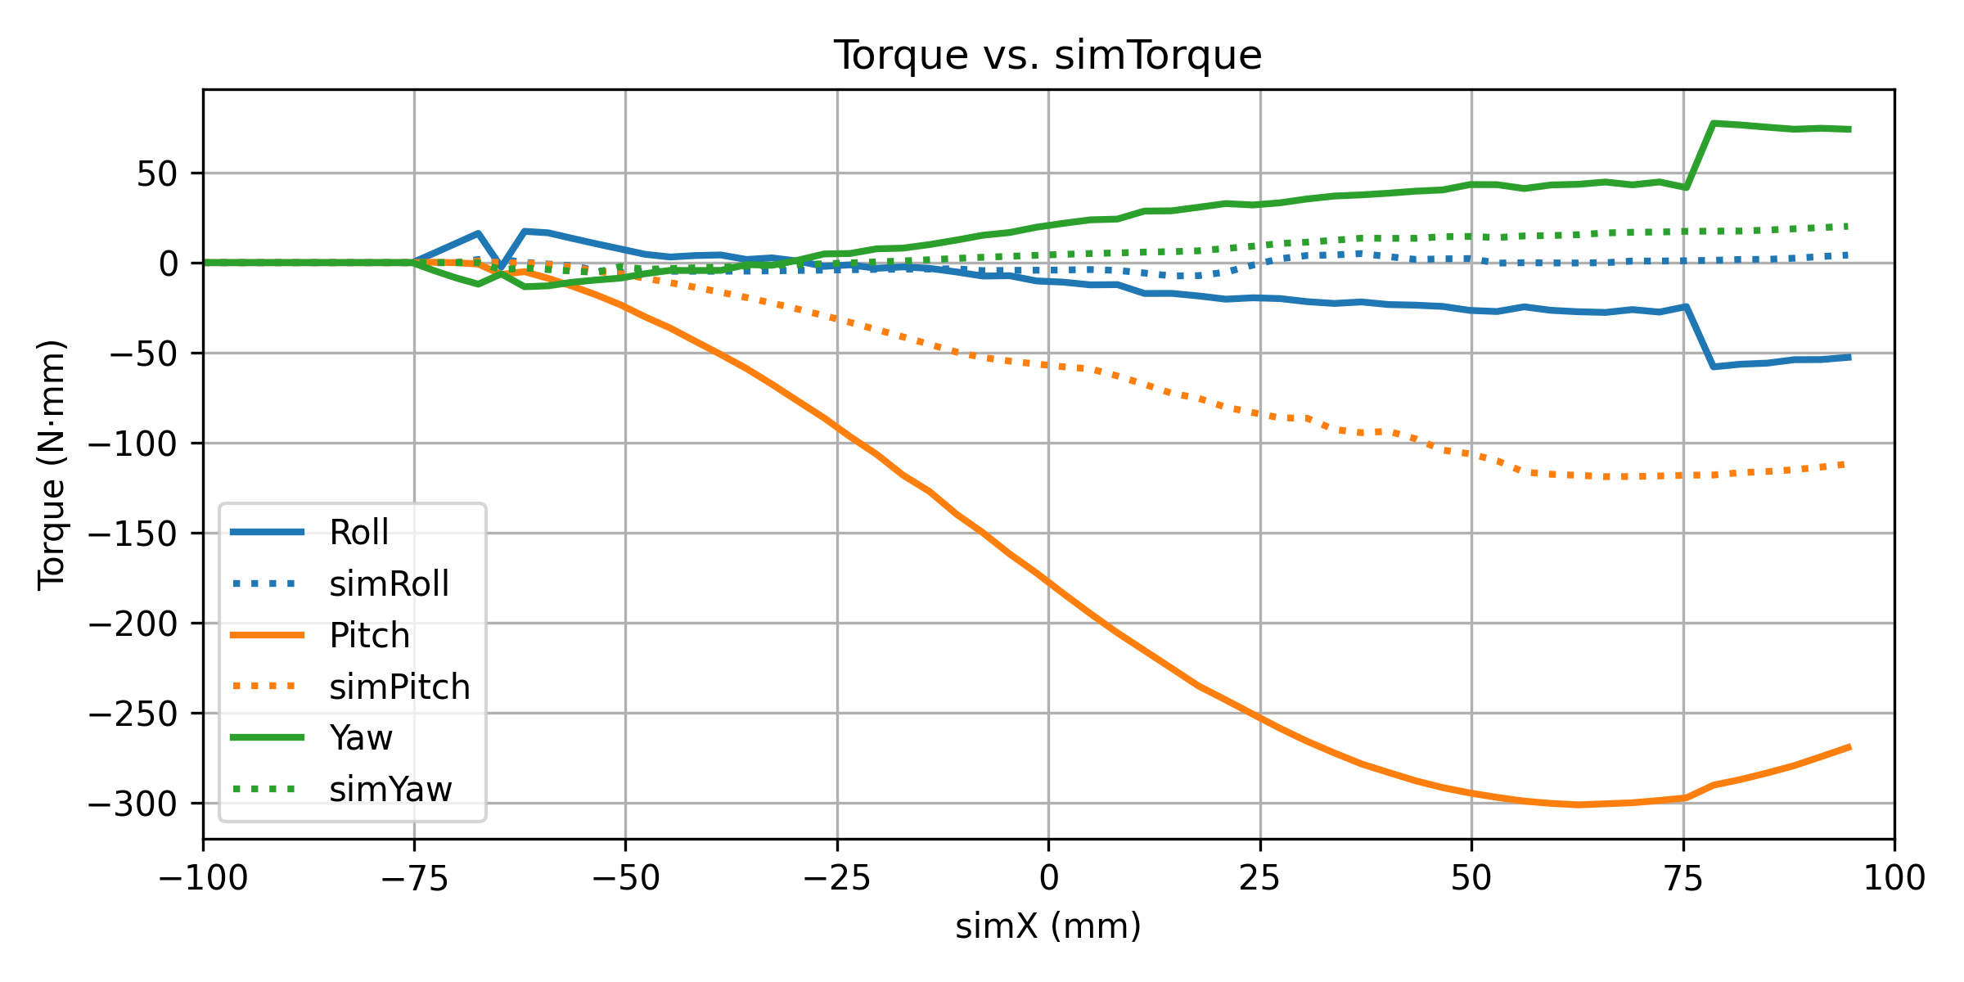
Data Analysis: Contact Model (Roll -5, Pitch -30)
d0 = 0.8 dwidth = 0.8
d0 = 0.995 dwidth = 0.9995
d0 = 1.0 dwidth = 1.0
The solid line is my data and dotted line is the expected result

Slide 10
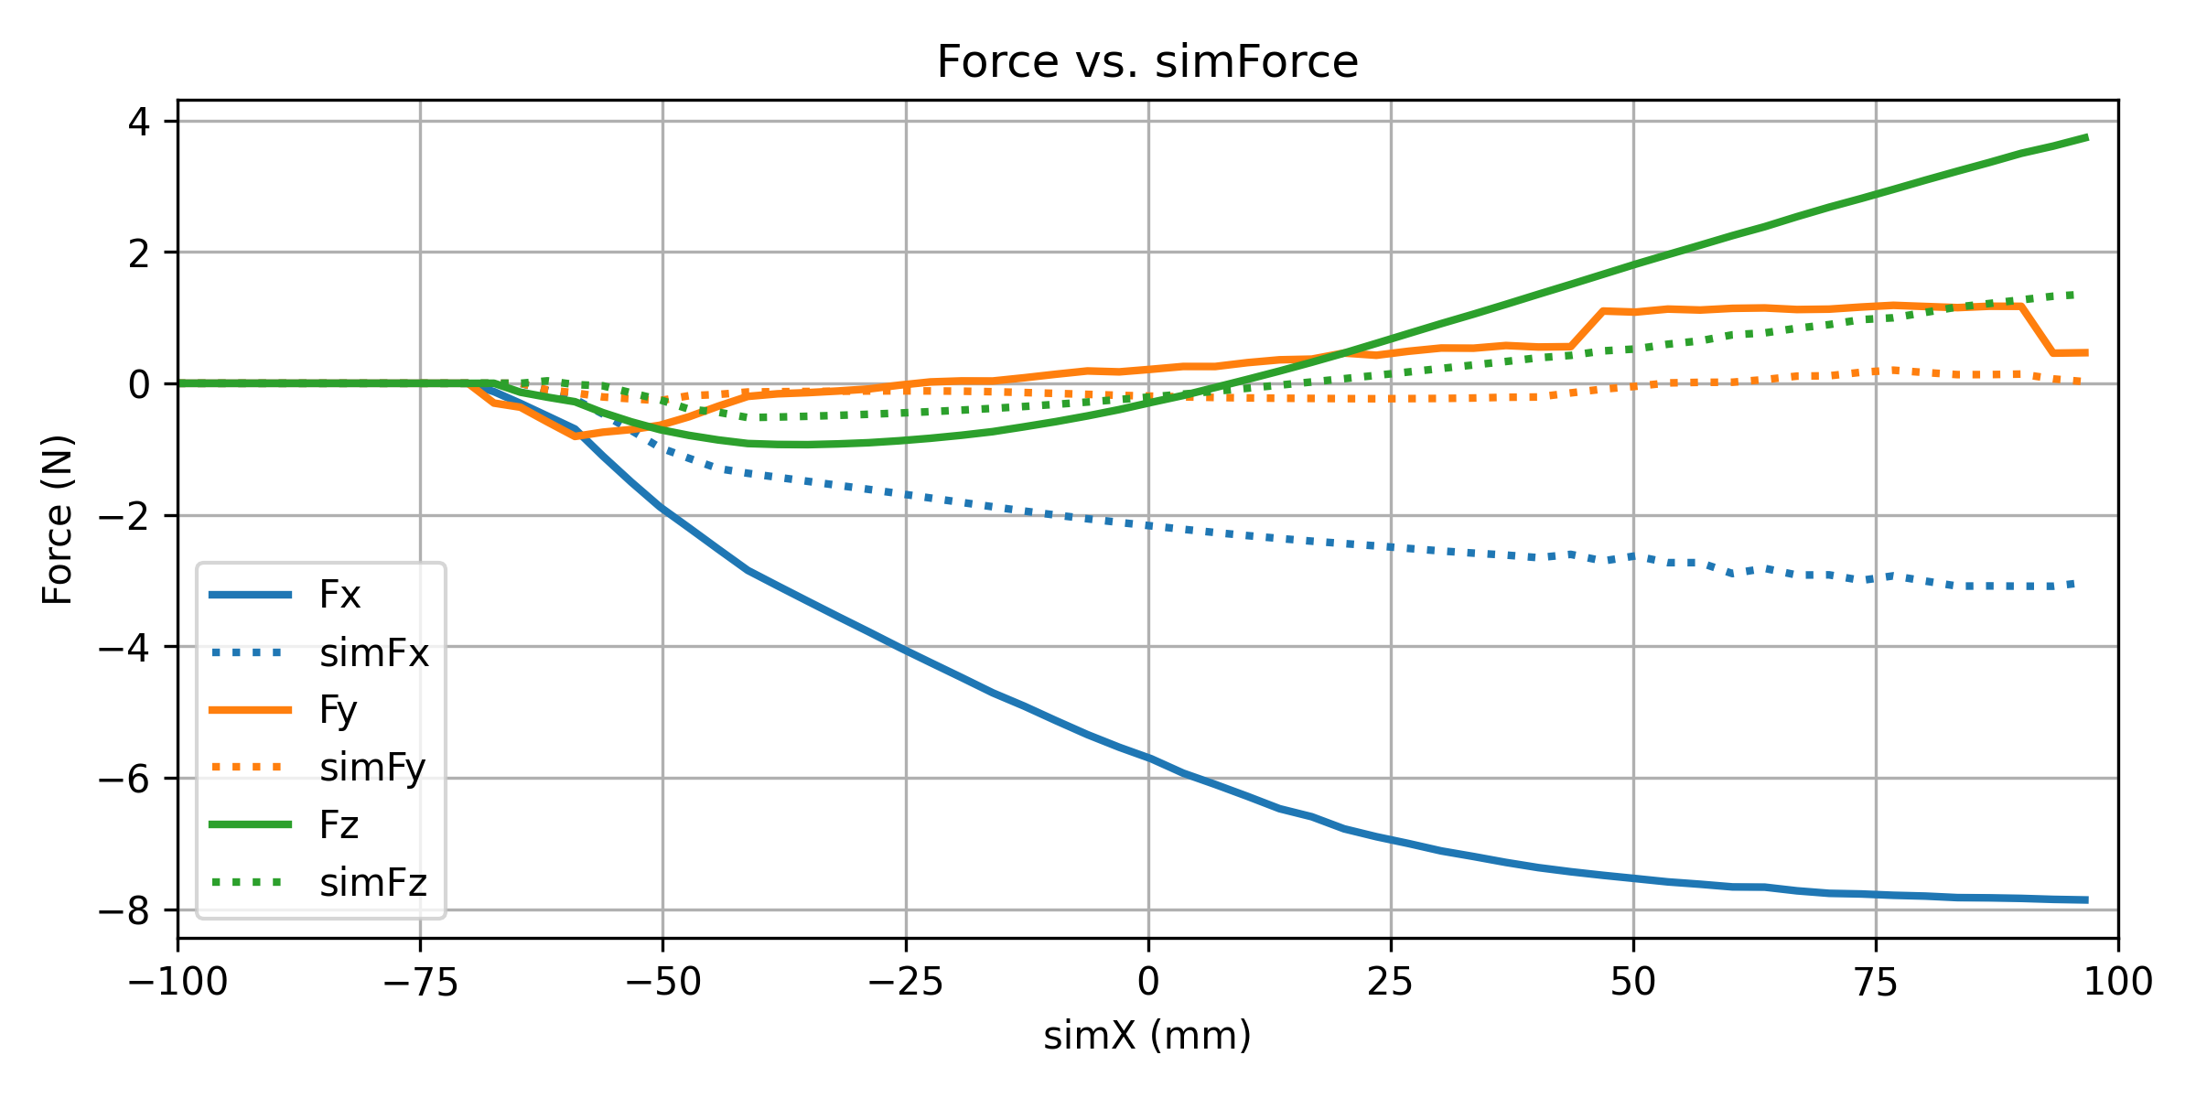
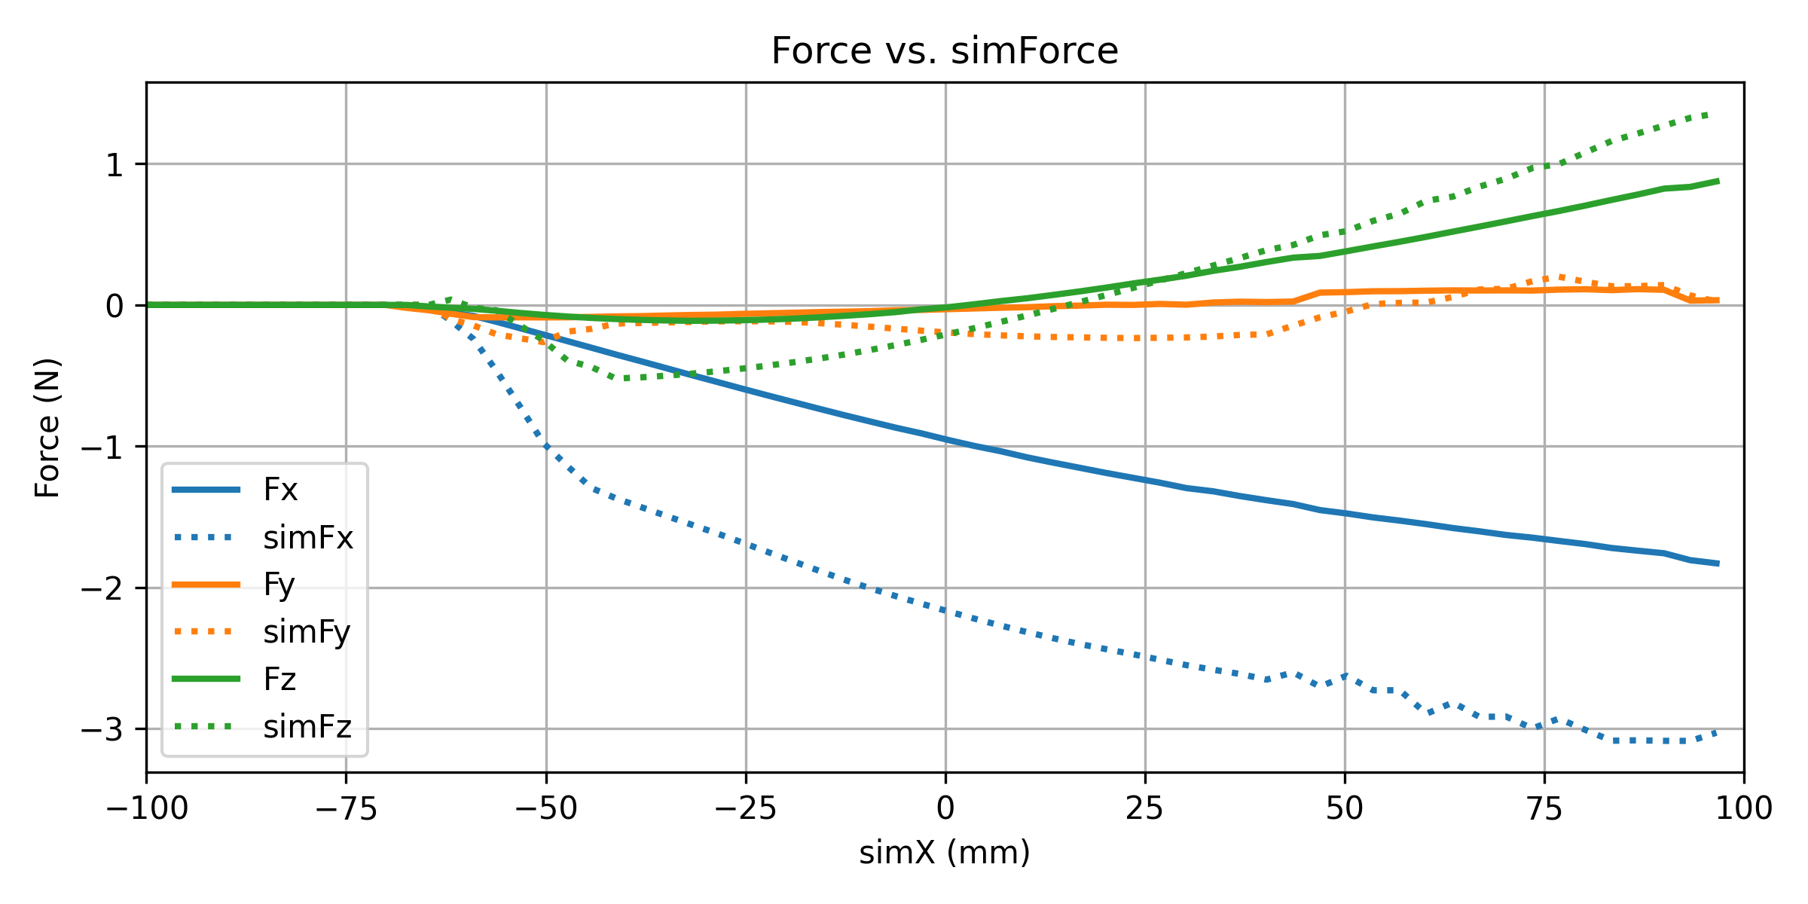
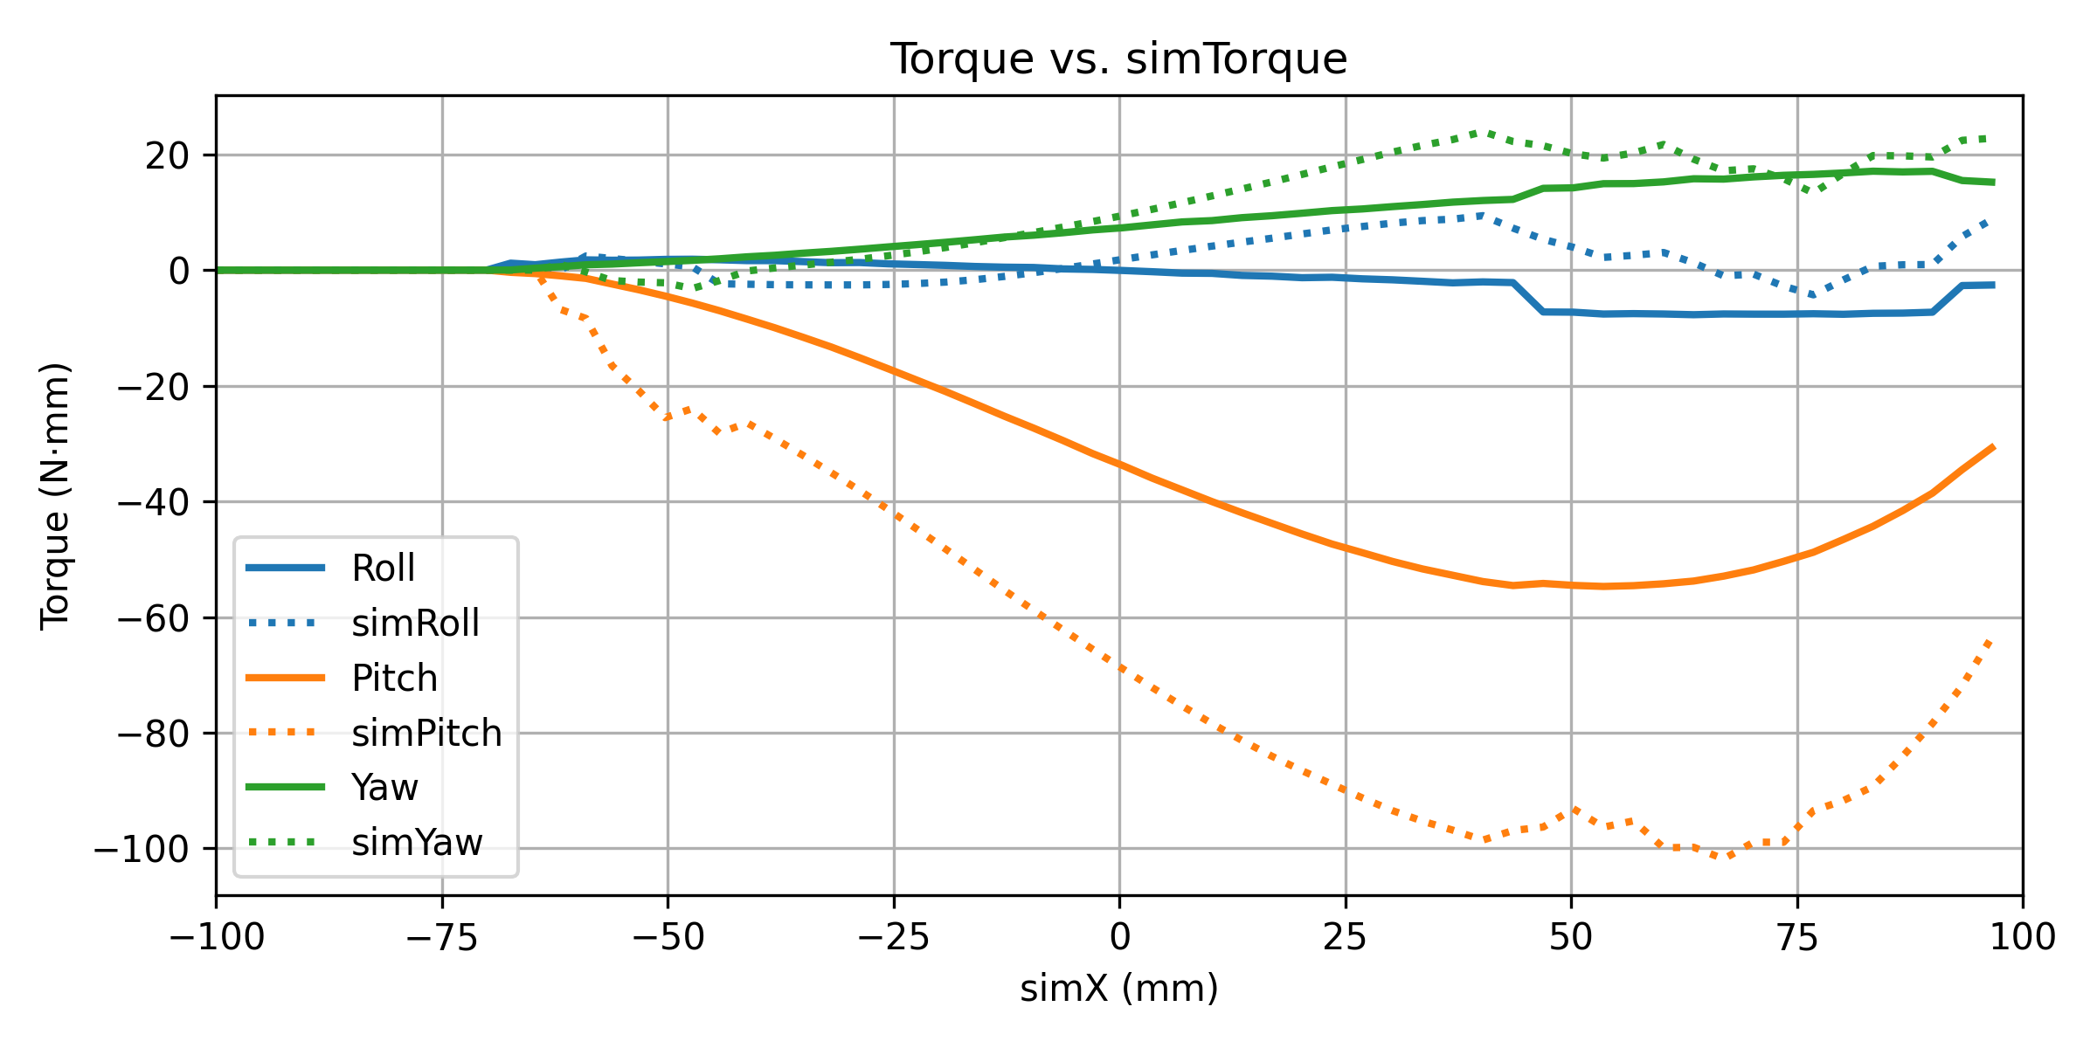
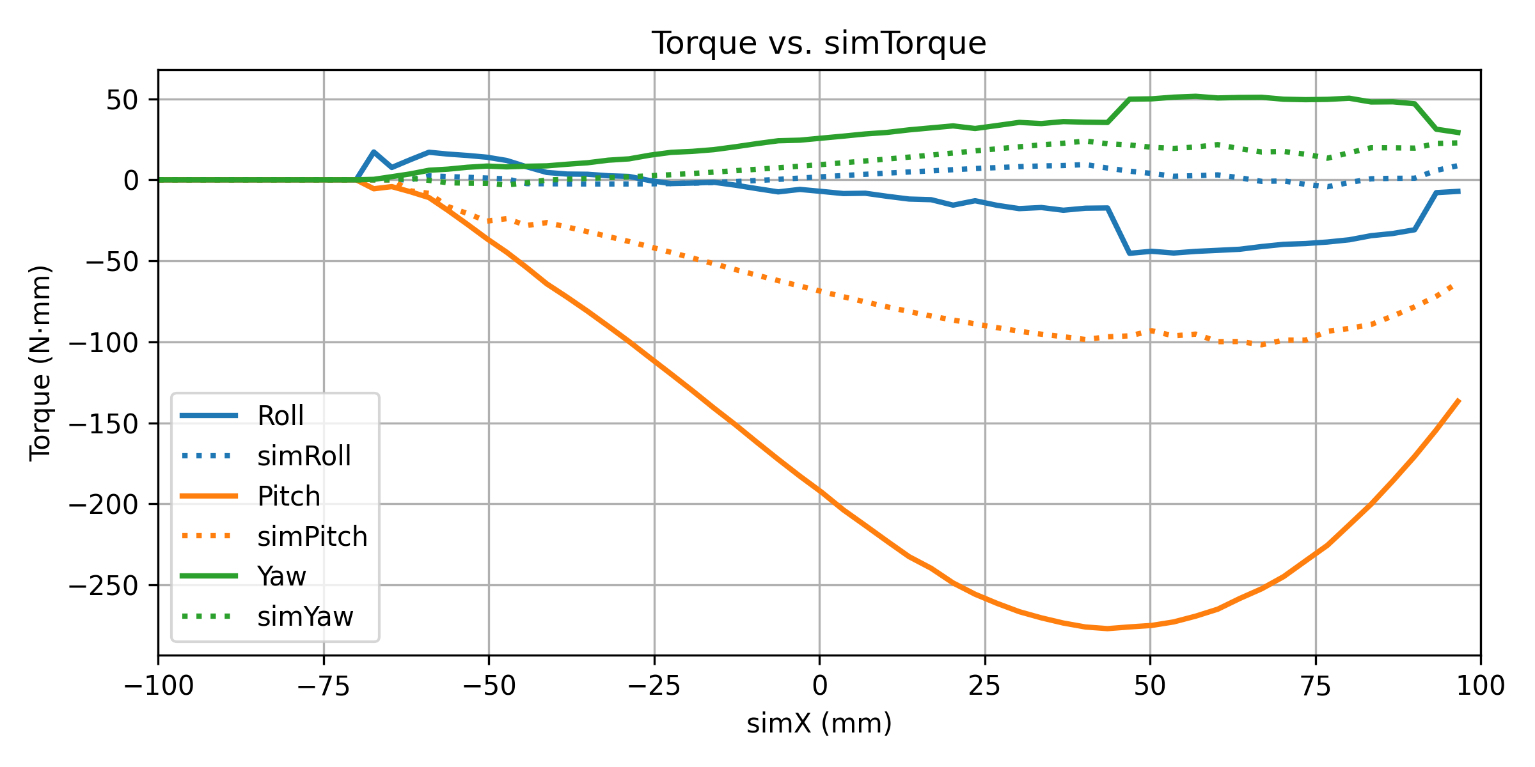
Data Analysis: Contact Model (Roll -5, Pitch -40)
d0 = 0.8 dwidth = 0.8
d0 = 0.995 dwidth = 0.9995
d0 = 1.0 dwidth = 1.0
The solid line is my data and dotted line is the expected result

Slide 11
Basic Model: Data Analysis – Friction
Friction (its testing is demonstrated in the next slides)
Increasing the friction coefficient amplifies the force Fx
Reducing friction will reduce Fx
Best match with simulation data at friction coefficient = 0.3
At 0.3, the results are overall consistent
Specifically, for Fx, the force initially increases more, and as the motion progresses, it stabilizes and flattens out, indicating a transition to a more linear stiffness region; for Fz, the force increases smoothly, corresponding to the continuous build-up of normal contact force

Slide 12
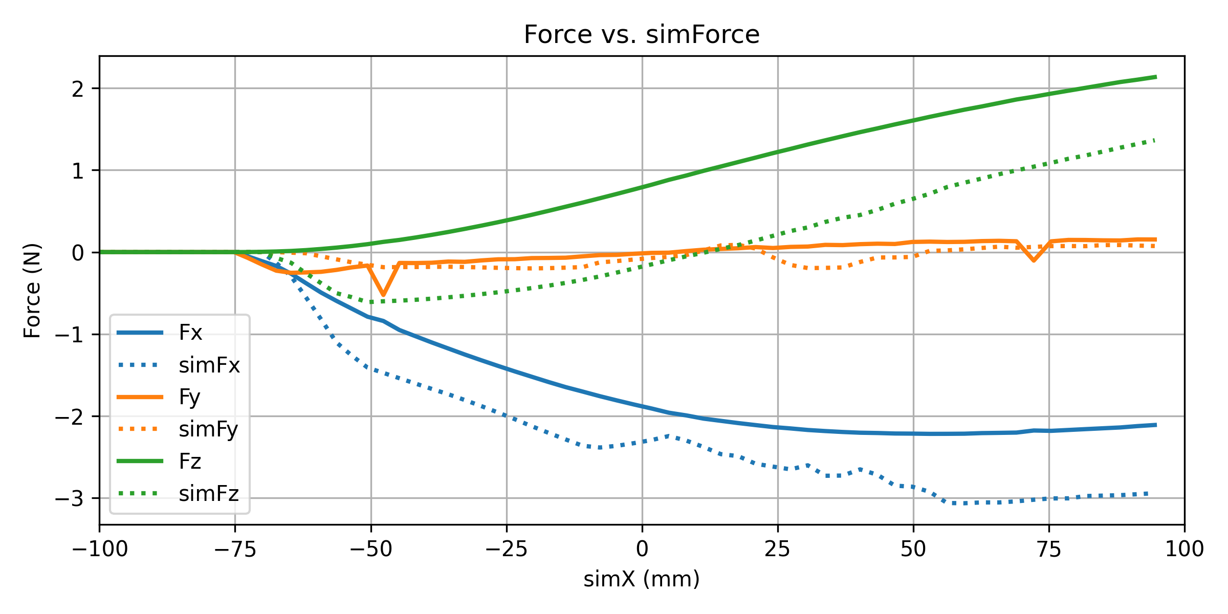
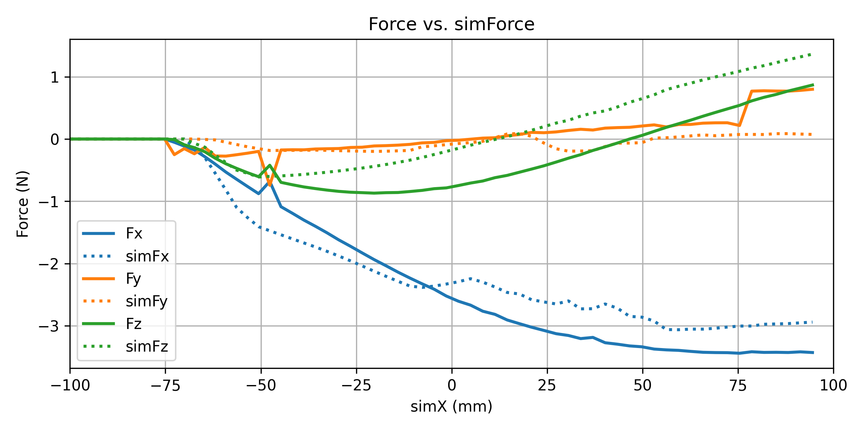
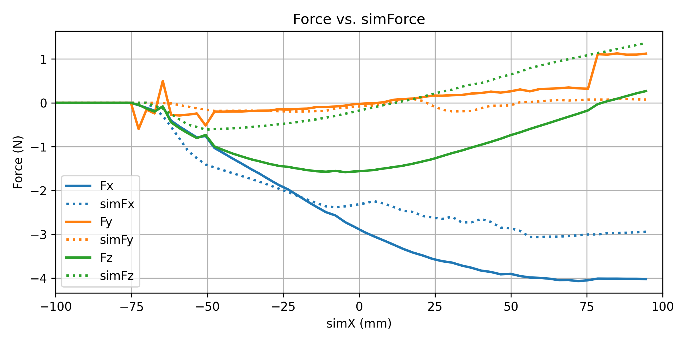
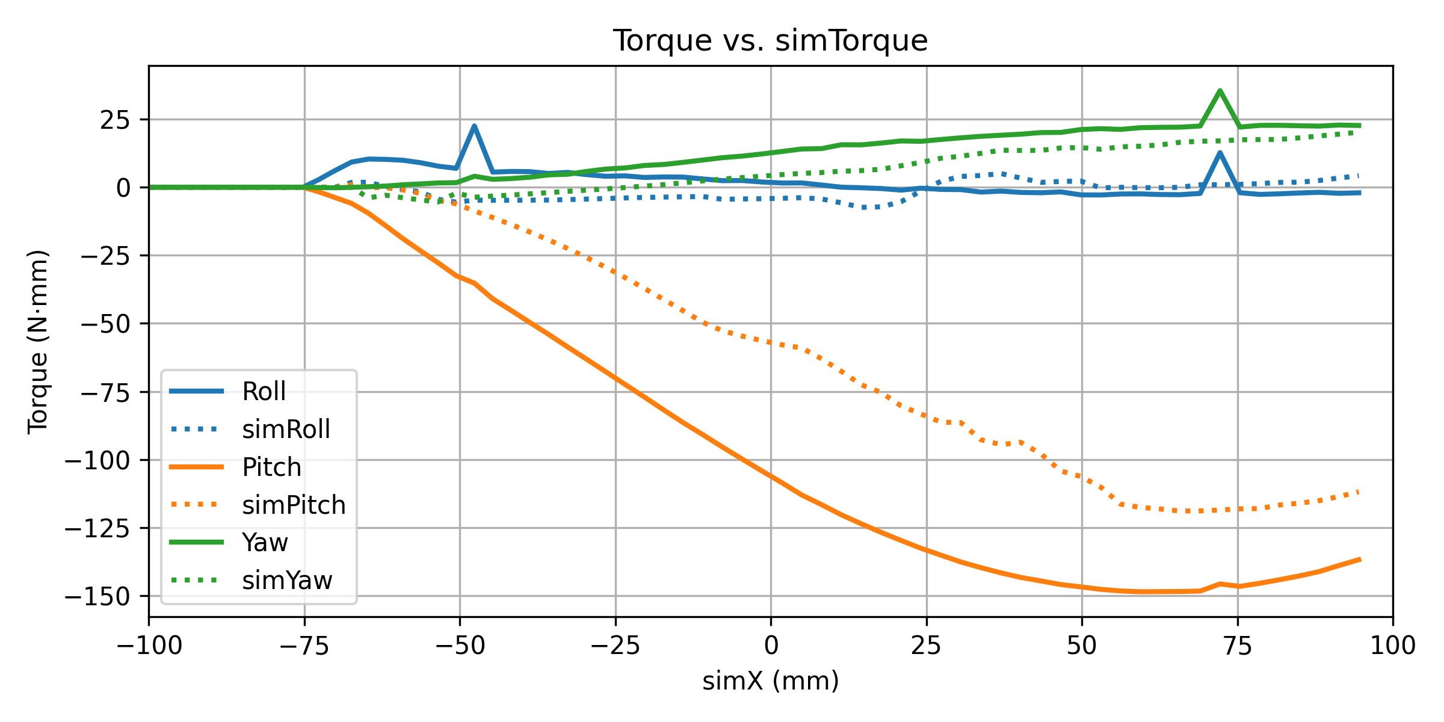
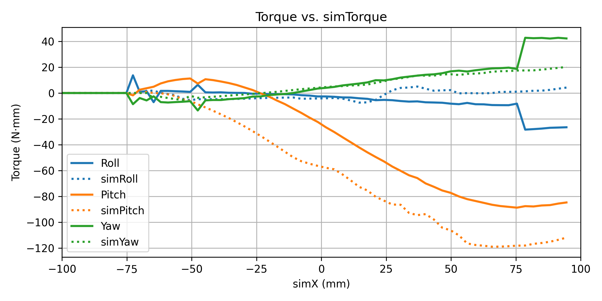
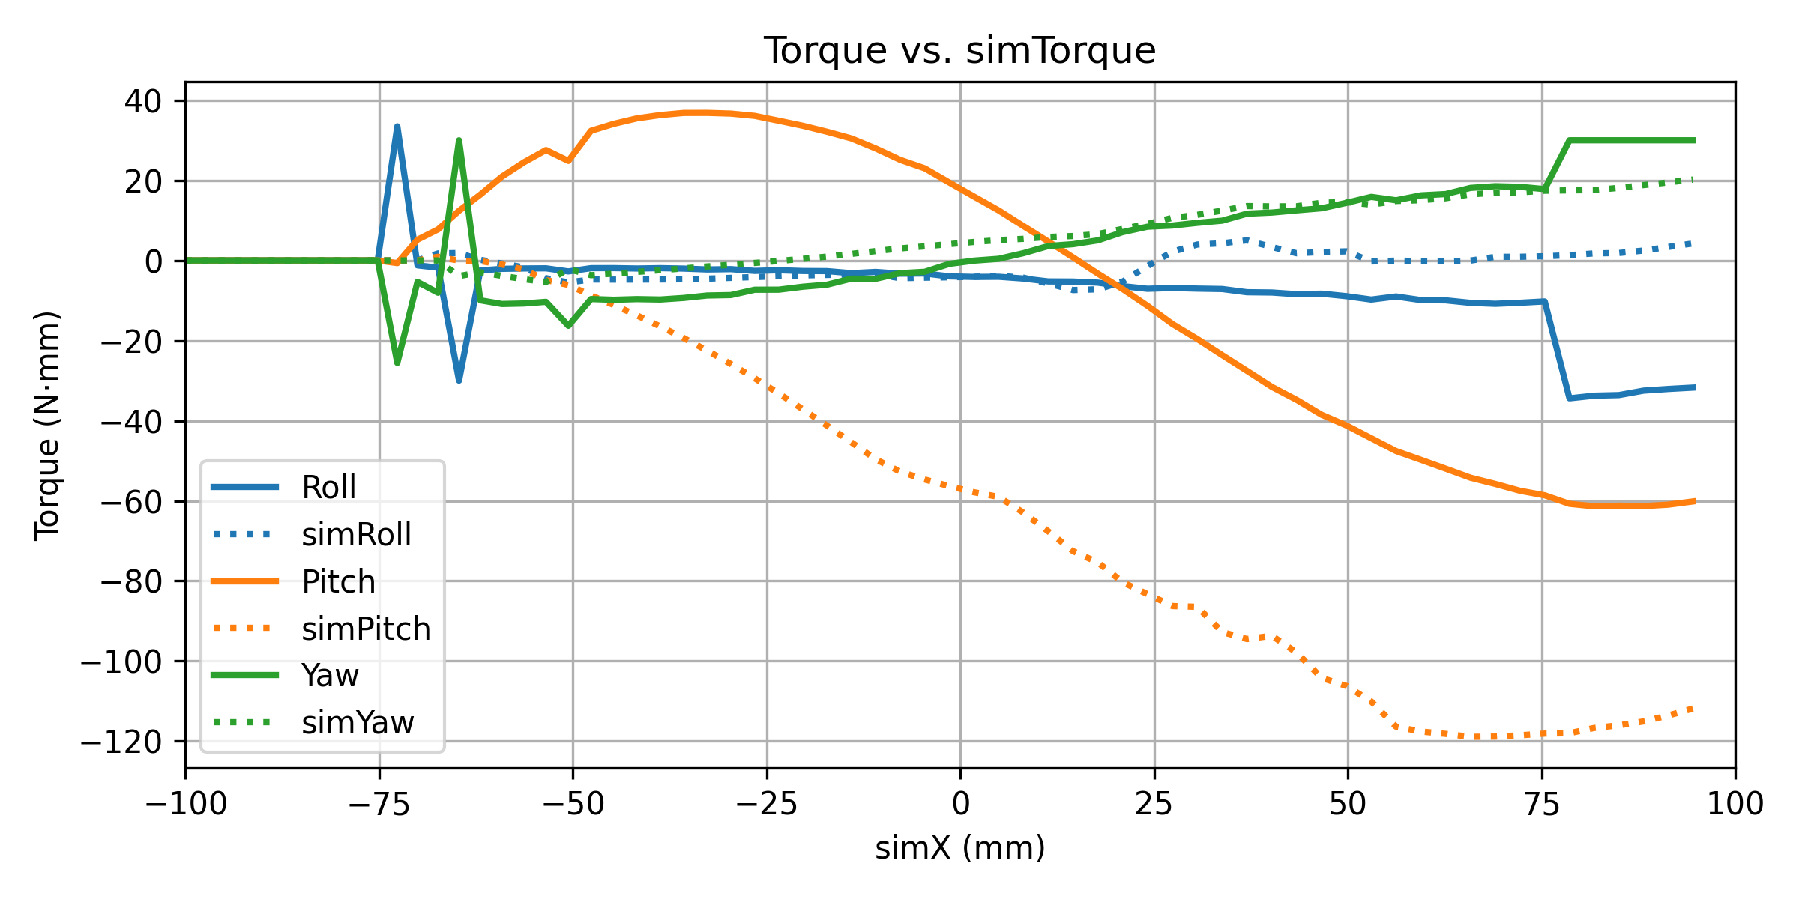
Data Analysis: Friction (Roll -5, Pitch -30)
No Friction
Friction coefficient = 0.3
Friction coefficient = 0.5
Friction coefficient = 0.7
The solid line is my data and dotted line is the expected result

Slide 13
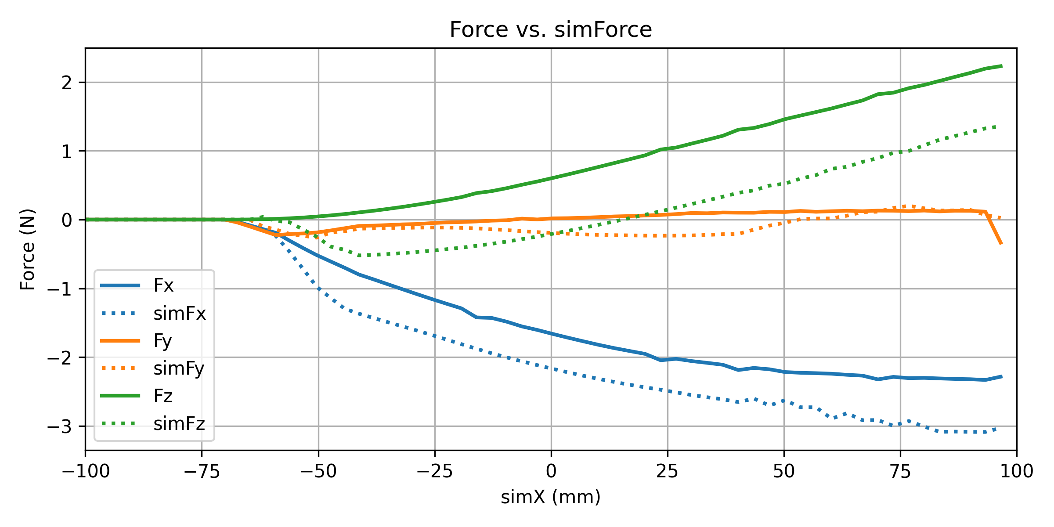
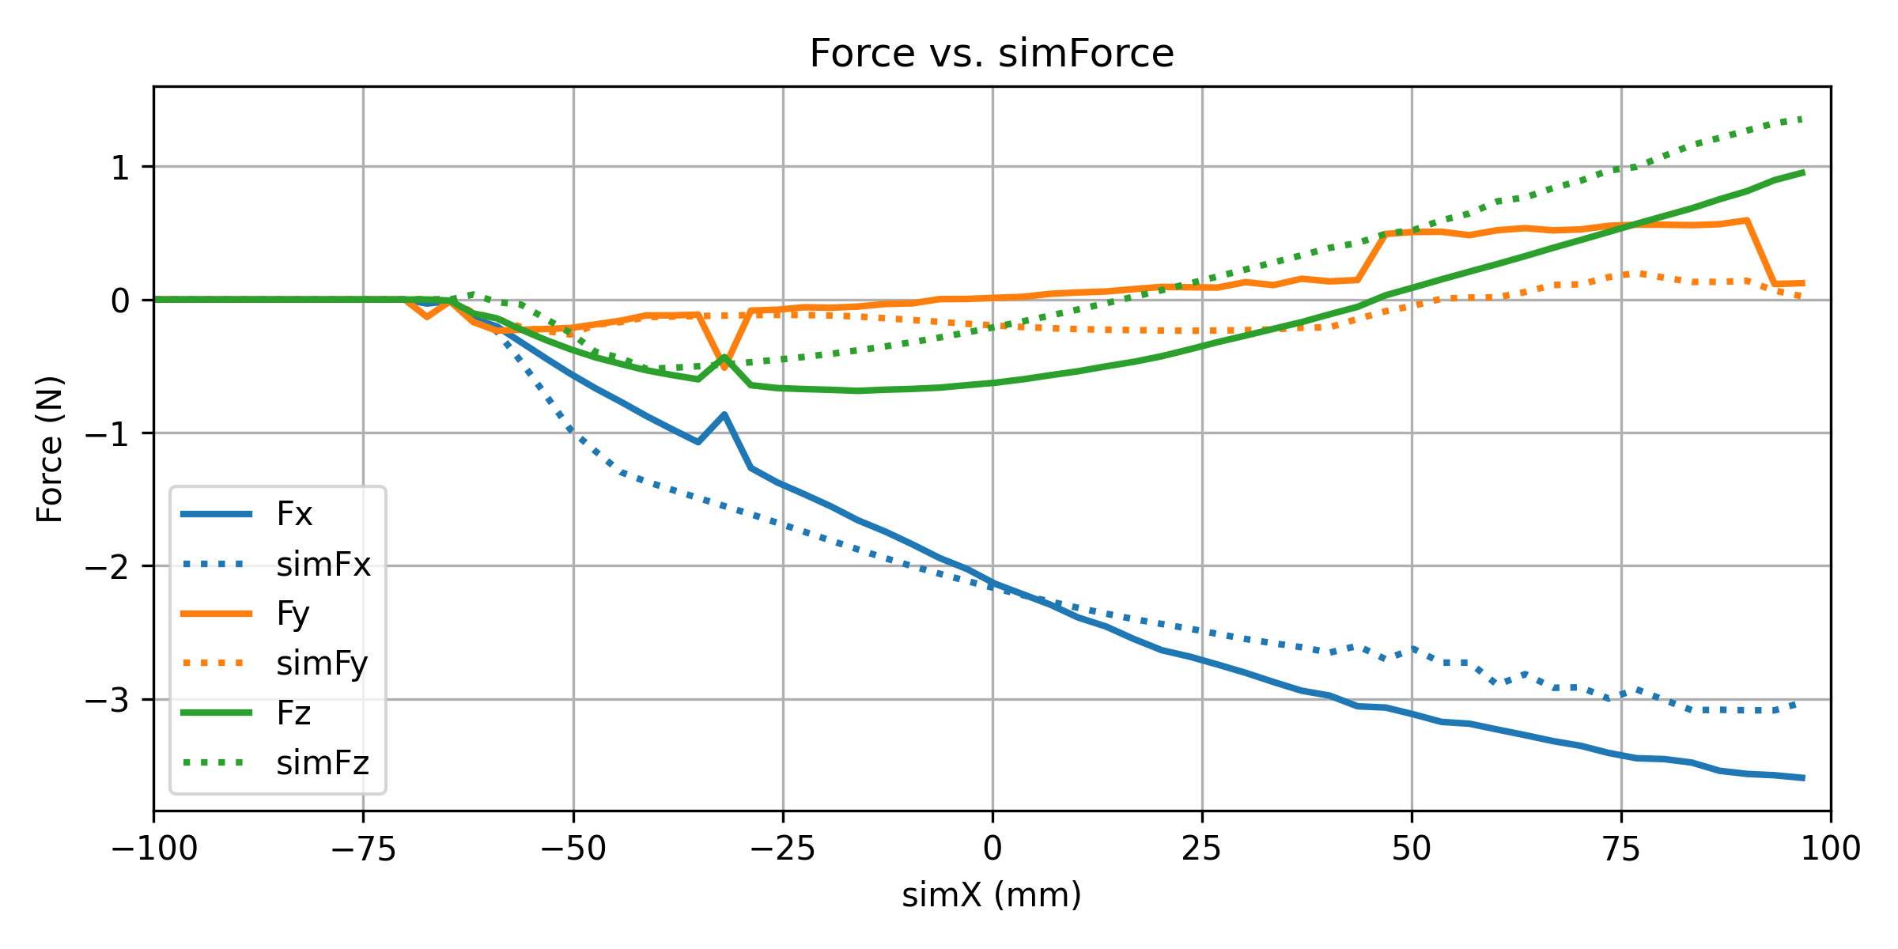
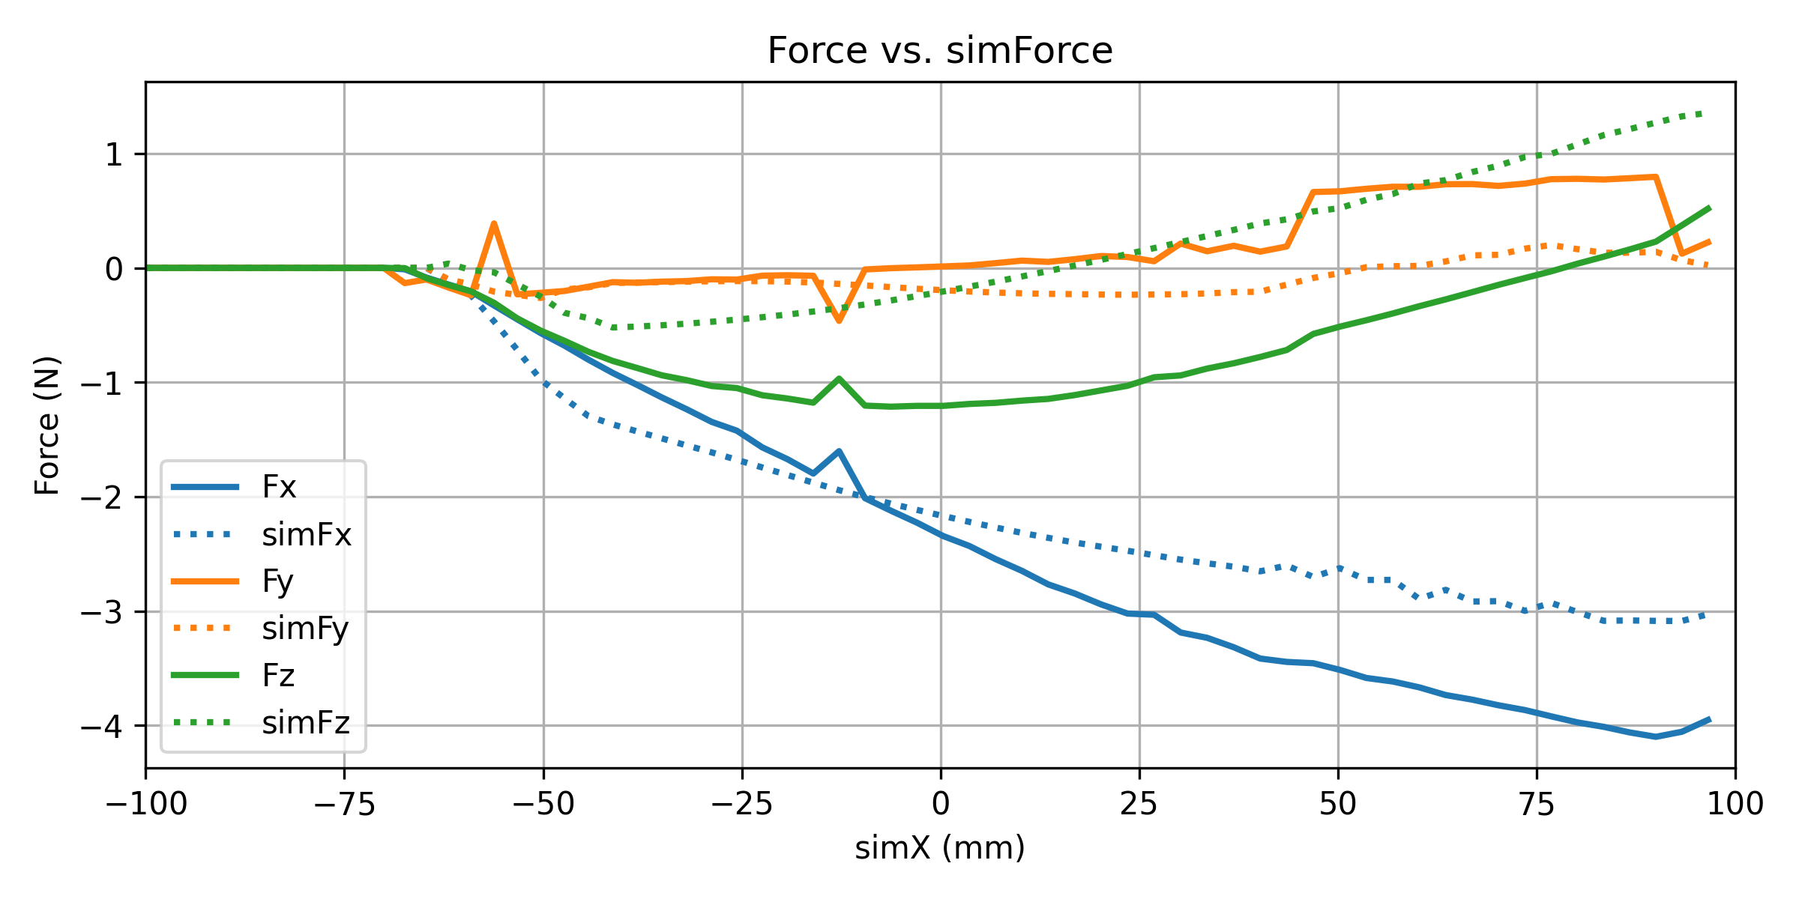
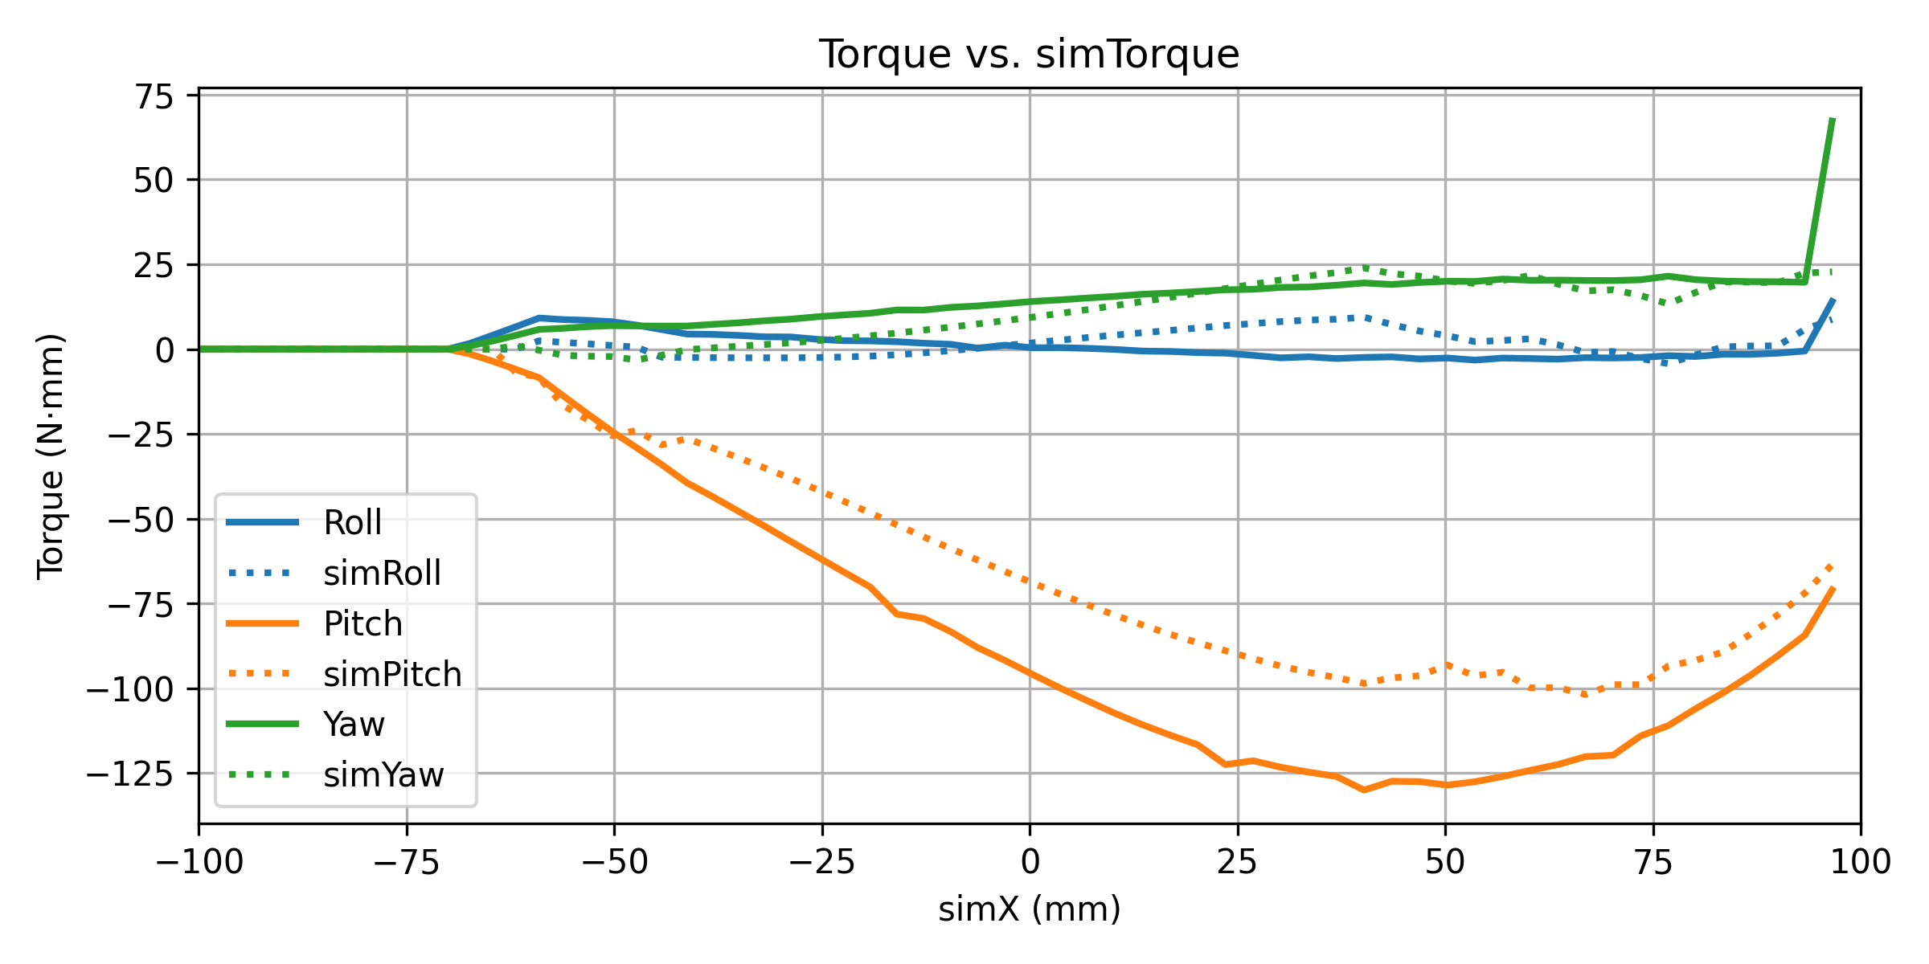
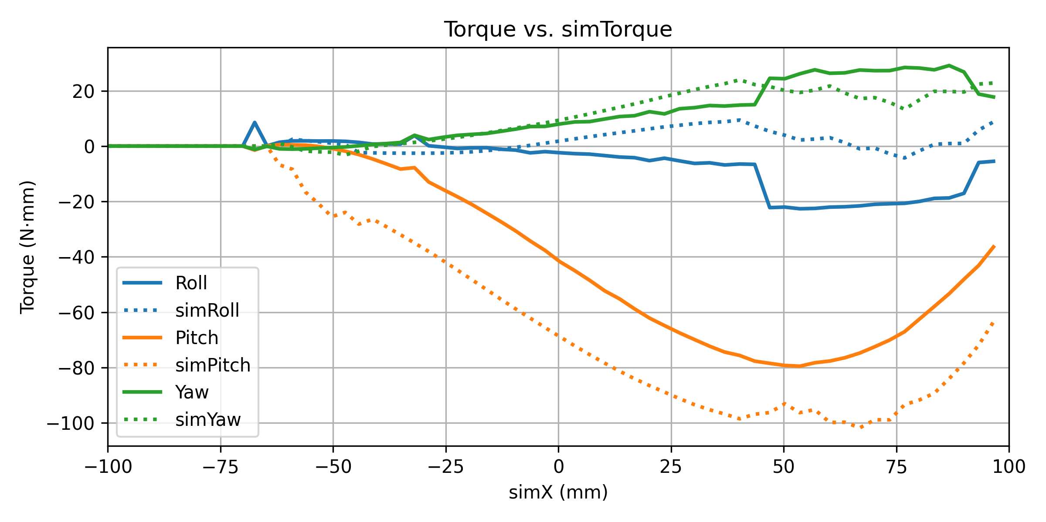
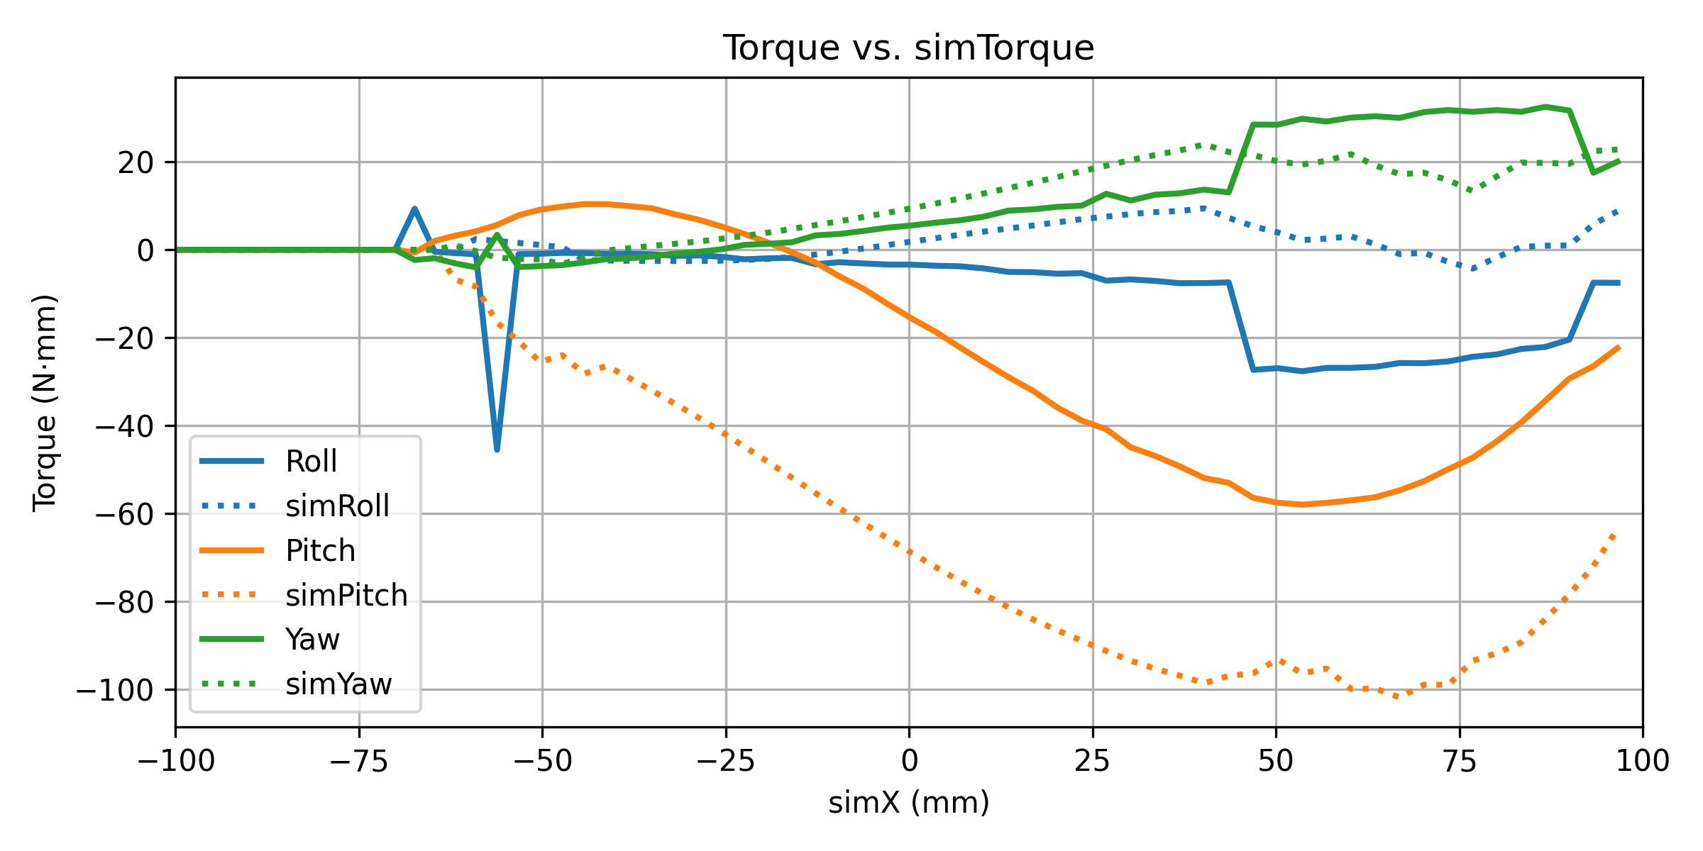
Data Analysis: Friction (Roll -5, Pitch -40)
No Friction
Friction coefficient = 0.3
Friction coefficient = 0.5
Friction coefficient = 0.7
The solid line is my data and dotted line is the expected result

Slide 14
Extended Model: Model Construction
Compared to the basic model
Roll and pitch rotations are not fixed at constant angles -> instead, they are allowed to freely change in response to interactions
Oscillation is added along the z-axis (combined with noise)
Goal for this model: Under different parameter settings (oscillation frequency and beam stiffness), the robot exhibits different behaviors
Only shows pitch oscillations while passing between the beams
The motion shifts into a rolling move

Slide 15
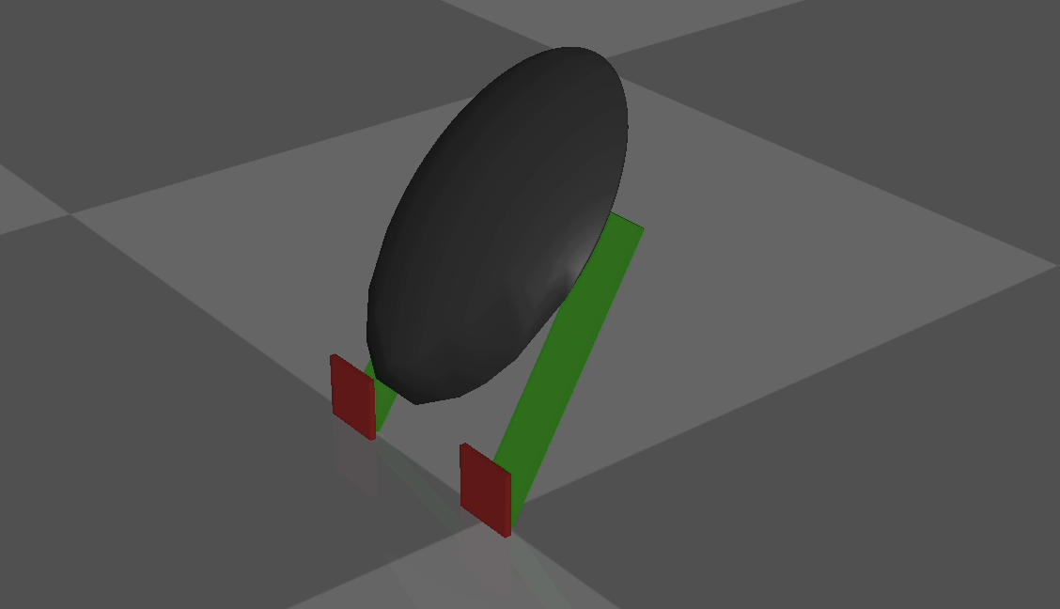
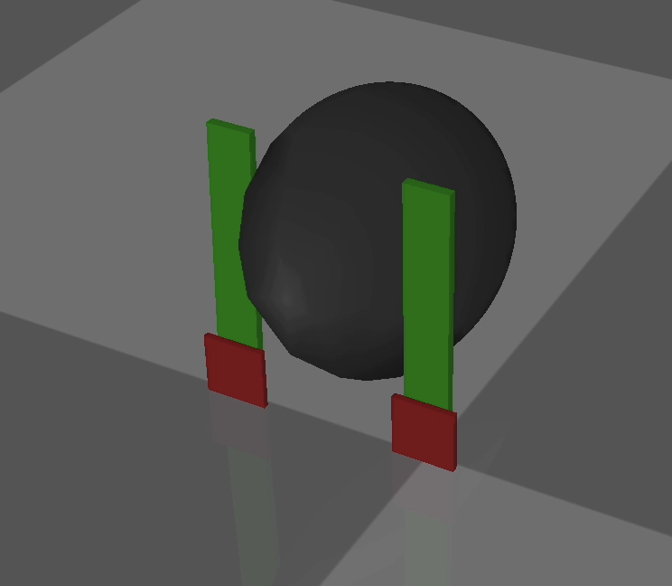
Extended Model: Model Construction
(1) When the robot pitches only
(2) When the robot rotates from pitch to roll

Slide 16
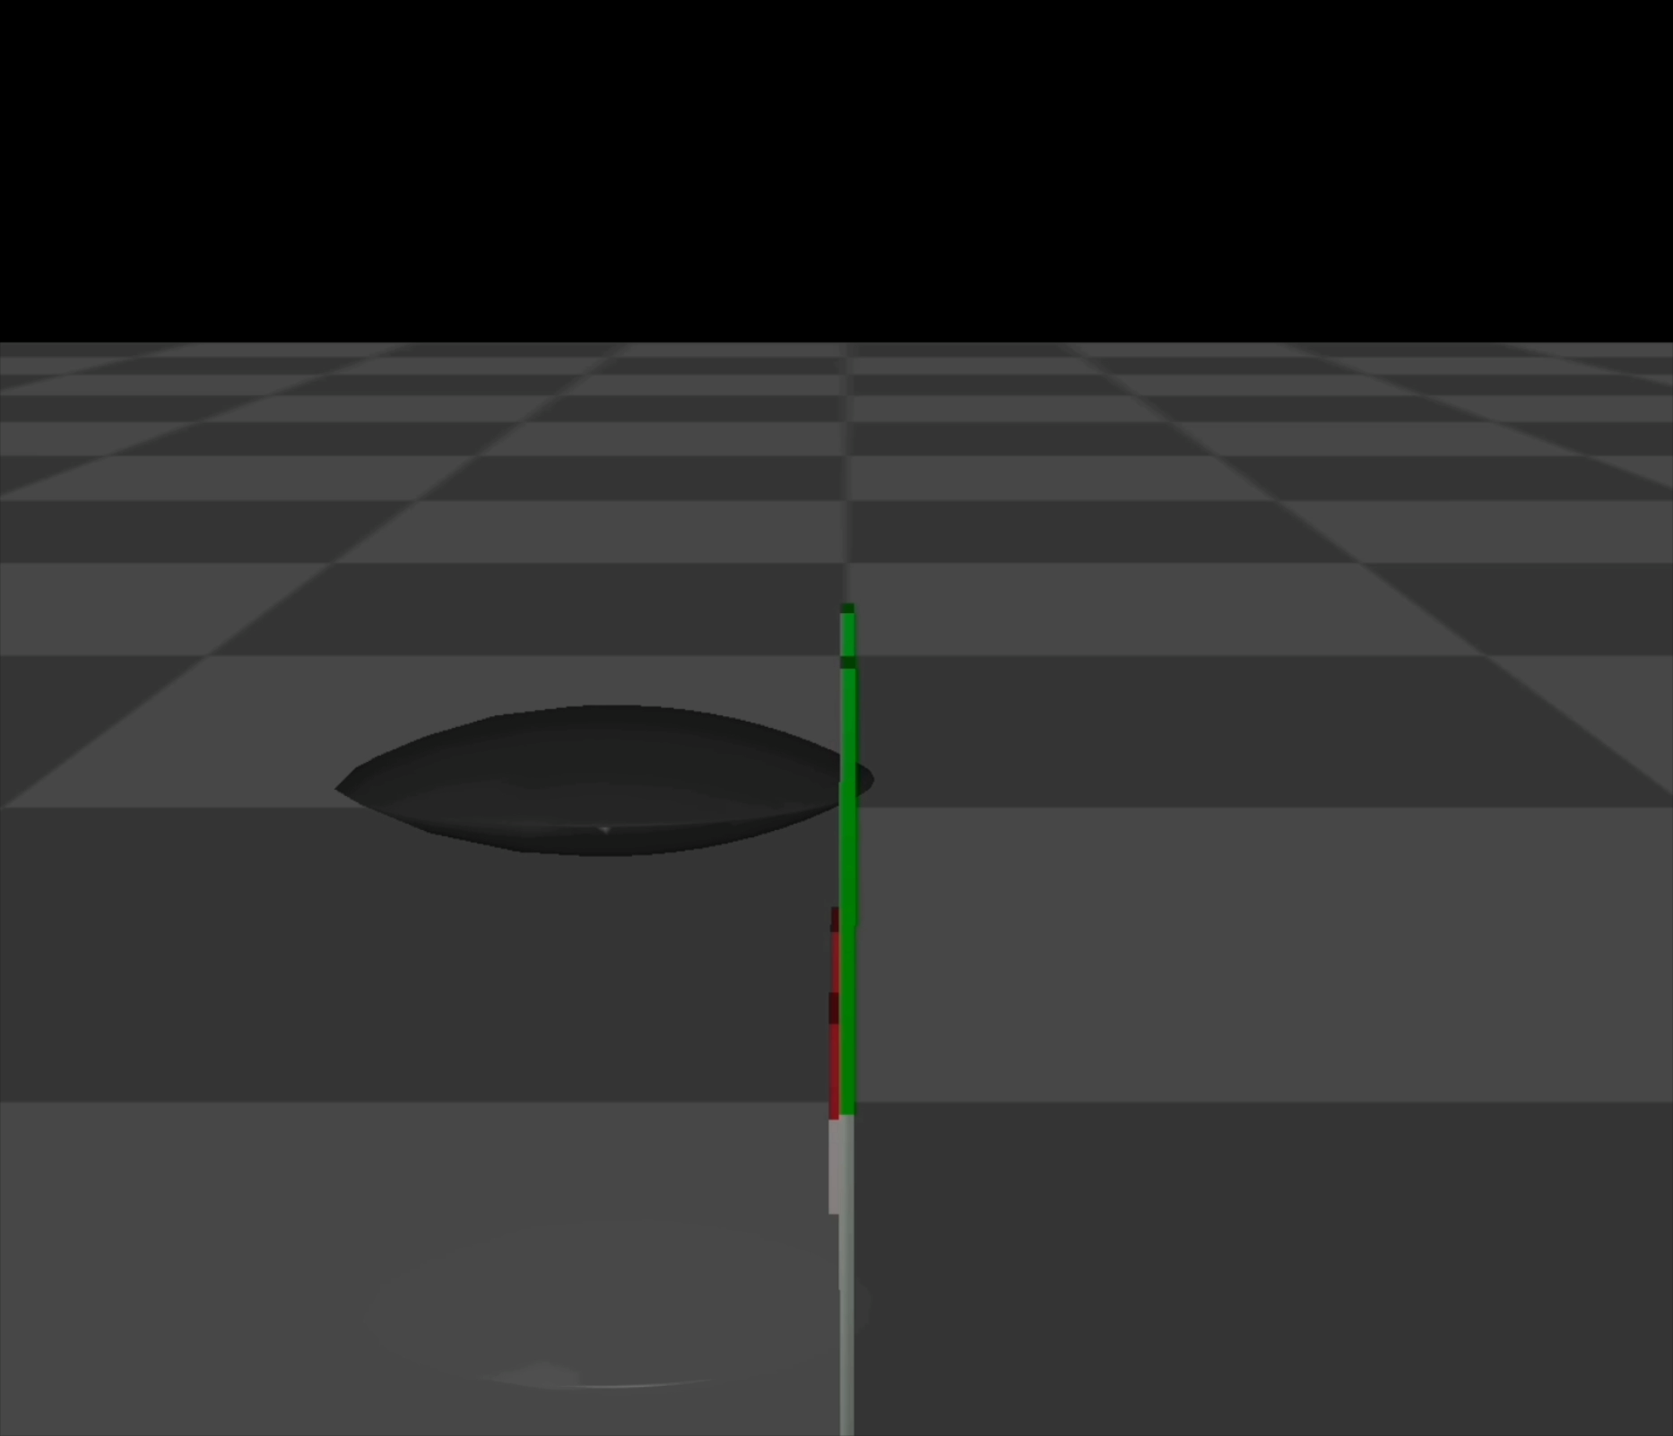
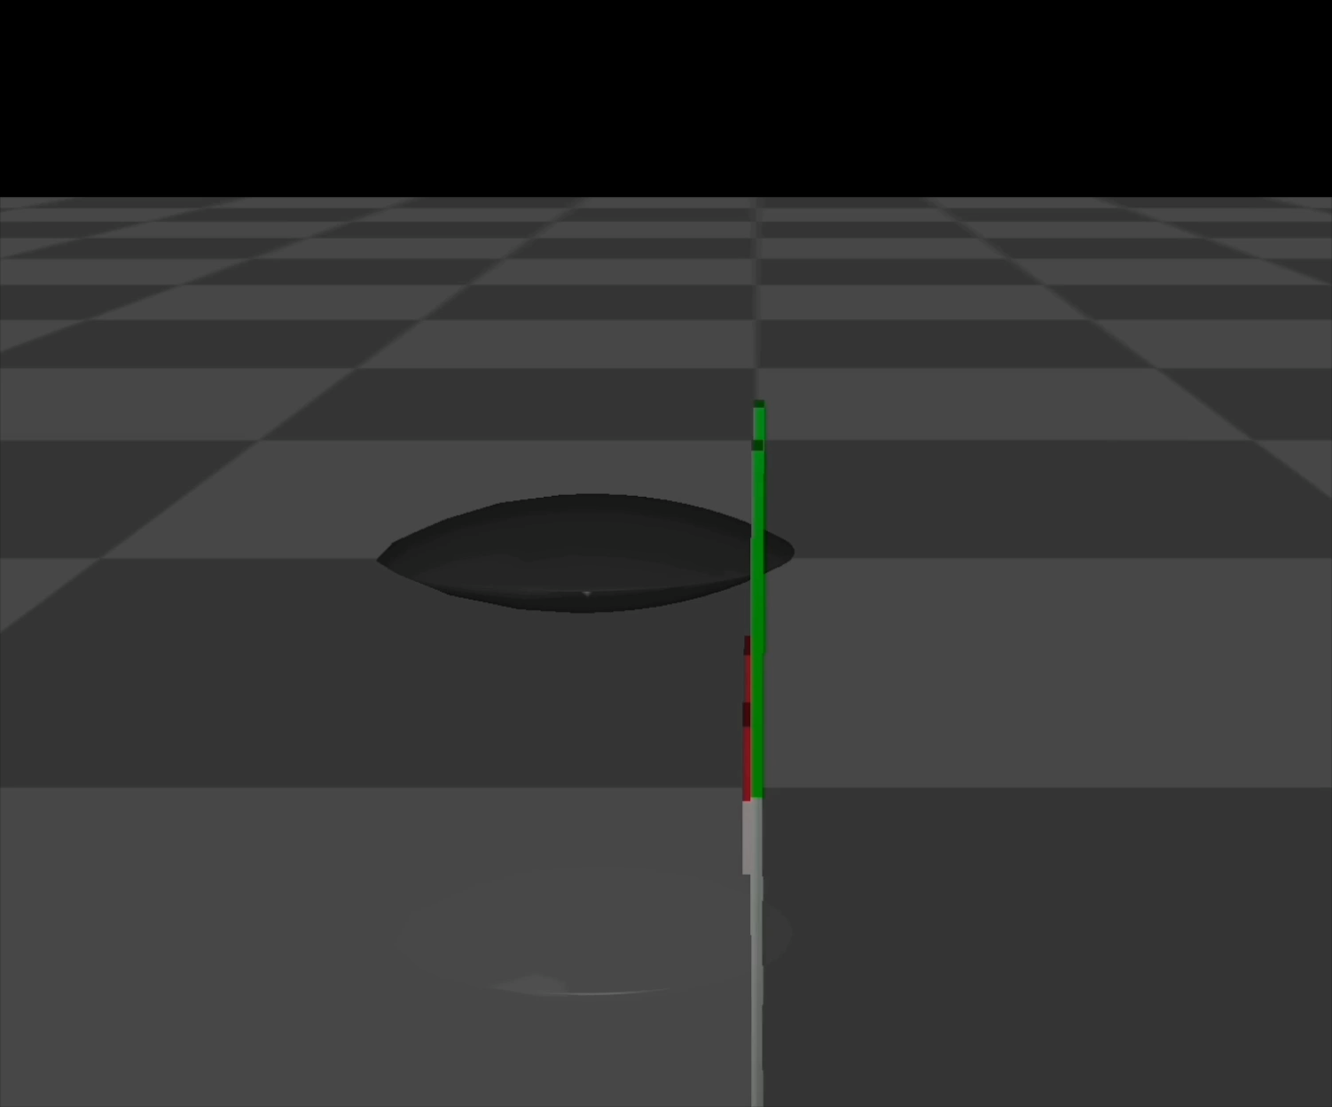
Extended Model: Model Construction
(1) Example: only pitch oscillation (0 Hz oscillation frequency, 28 mN·m/rad beam stiffness)
(2) Example: transition from pitch to roll motion (6 Hz oscillation frequency, 344 mN·m/rad beam stiffness)

Slide 17
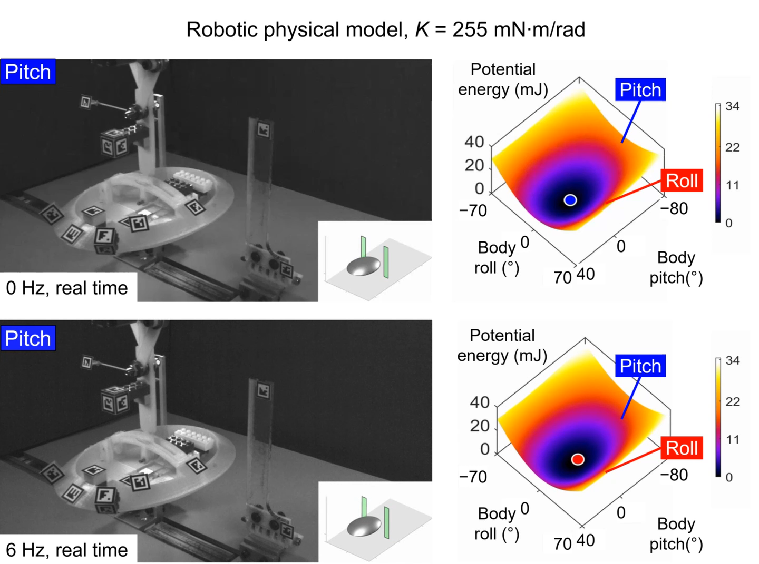

Extended Model: Model Construction (Comparison)
Large body oscillation

Slide 18
Extended Model: Data Analysis (1)
Goal: For different oscillation frequencies, evaluate the probability of transitions from pitch to roll under varied stiffnesses of the beams
Test Settings:
Oscillation frequencies: 0 Hz to 6 Hz
Beam stiffness values: [28, 55, 255, 344] mN·m/rad
For each oscillation frequency under each beam stiffness, run 50 trials to calculate the transition probability from pitch to roll
Note: Tested under the same contact model settings

Slide 19





Extended Model: Data Analysis (1) – Stiffness
Stiffness = 0.1 Nm/rad
Stiffness = 0.3 Nm/rad
Experimental data
Stiffness = 0.5 Nm/rad
Stiffness = 0.7 Nm/rad

Slide 20
Extended Model: Data Analysis (1) – Stiffness
Torsional Stiffness
Increasing the stiffness strengthens the normal reactional forces during interaction, leading to higher pitch-to-roll transition probabilities across all frequencies
Decreasing contact stiffness weakens the forces, reducing the likelihood of transition
Best match with simulation data at torsional stiffness = 0.5 Nm/rad
At 0.5 Nm/rad, the results are overall consistent
Specifically, as the oscillation frequency increases, the probability of transitioning from pitch to roll increases; also, increasing the stiffness of the beam makes it more likely for the robot to transition from pitch to roll

Slide 21


Extended Model: Data Analysis (1) – Timesteps
Timesteps = 0.0005 s
Timesteps = 0.0010 s
Timesteps = 0.0015 s
Experimental data
Based on the pitch-to-roll transition probabilities, tested at timesteps of 0.0005 s, 0.001s, and 0.0015 s, the results show near-identical trends and values, indicating that the simulation has converged -> MuJoCo is not highly sensitive to timestep in this range

Slide 22
Extended Model: Data Analysis (2)
Goal: Examine transition time and traversal time across different oscillation frequencies and varying beam stiffness levels
Transition time: the time for the robot to transition from pitch motion to full roll motion (none if the robot only pitches during traversal)
Traversal time: the total time from when the robot first contacts the beams until it crosses them
Test Settings:
Oscillation frequencies: 0 Hz to 6 Hz
Beam stiffness values: [28, 55, 255, 344, 516] mN·m/rad, referred to as K1 through K5 in the plots
For each frequency and stiffness combination, 10 trials were conducted to compute the average traversal and transition times
Note: Tested under the same contact model settings & a torsional stiffness of 0.5 Nm/rad

Slide 23


Extended Model: Data Analysis (2)
Result
Time vs Frequency
Experimental data

Slide 24


Extended Model: Data Analysis (2)
Result
Experimental data
Time vs Stiffness (Same data but plotted with stiffness on the x-axis)

Slide 25
Extended Model: Data Analysis (2)
(1) Overall, the result is consistent with experimental data
Most of the data points fall within the error margins of experimental ta
As beam stiffness increases (from K1 to K5), both transition time and traversal time decrease – a trend that matches experimental data
As oscillation frequency increases (from 0 Hz to 6 Hz), both transition time and traversal time decrease – another trend that matches experimental data

Slide 26
Extended Model: Data Analysis (2)
(2) Differences (circled in black):
This is because at lower frequencies (0 Hz), the robot in my model only pitches in every trial, with no transition to roll -> no transition time is recorded, and traversal time is longer because the robot takes longer to cross the beam when only pitches
But this behavior is expected and consistent with the previous result (p. 12), which shows that the probability of transitioning from pitch to roll decreases significantly at lower frequencies

